Slide 1
Simple Load Pull Report
None

Slide 2
Test Configuration
Frequencies: (GHz)
8.9, 9.4, 9.9, 10.4, 10.9, 11.4, 11.9
Input Powers: (dBm)
14, 16, 18, 22
Load Impedances:
Gamma Magnitude:
0.1, 0.2, 0.3, 0.4, 0.5
Gamma Phase
-175, -165, -155, -145, -135, -125, -115, -105, -95, -85, -75, -65, -55, -45, -35, -25, -15, -5, 5, 15, 25, 35, 45, 55, 65, 75, 85, 95, 105, 115, 125, 135, 145, 155, 165, 175

Slide 3
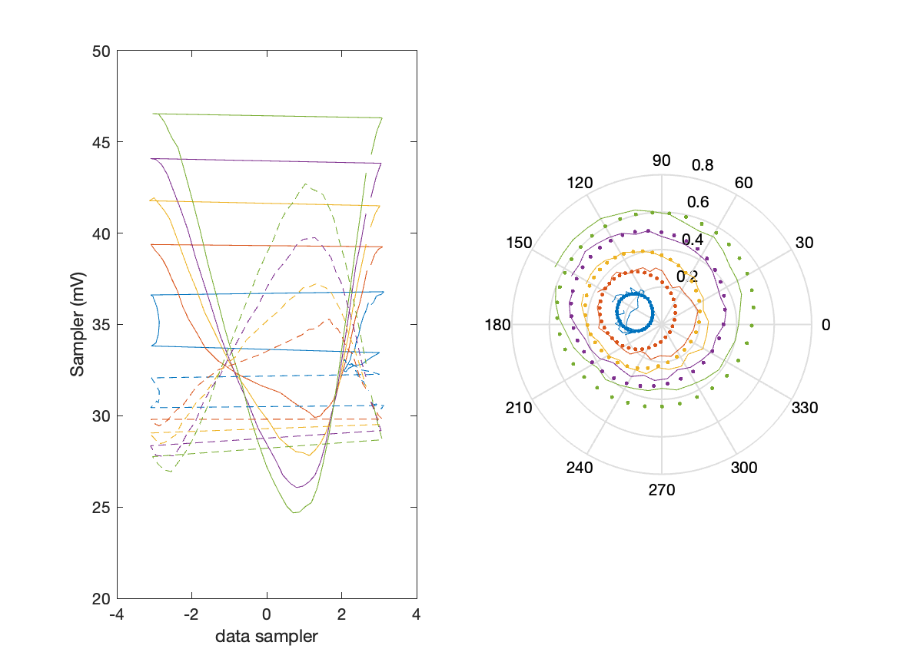
Sampler Performance Frequency 10.40 GHz, Power 14 dBm
Sampler Av
Sampler 1: 35.896
Sampler 2: 54.013
Sampler Offset (rather than -1)
-2.9095
Goodness Of fit
0.15881

Slide 4
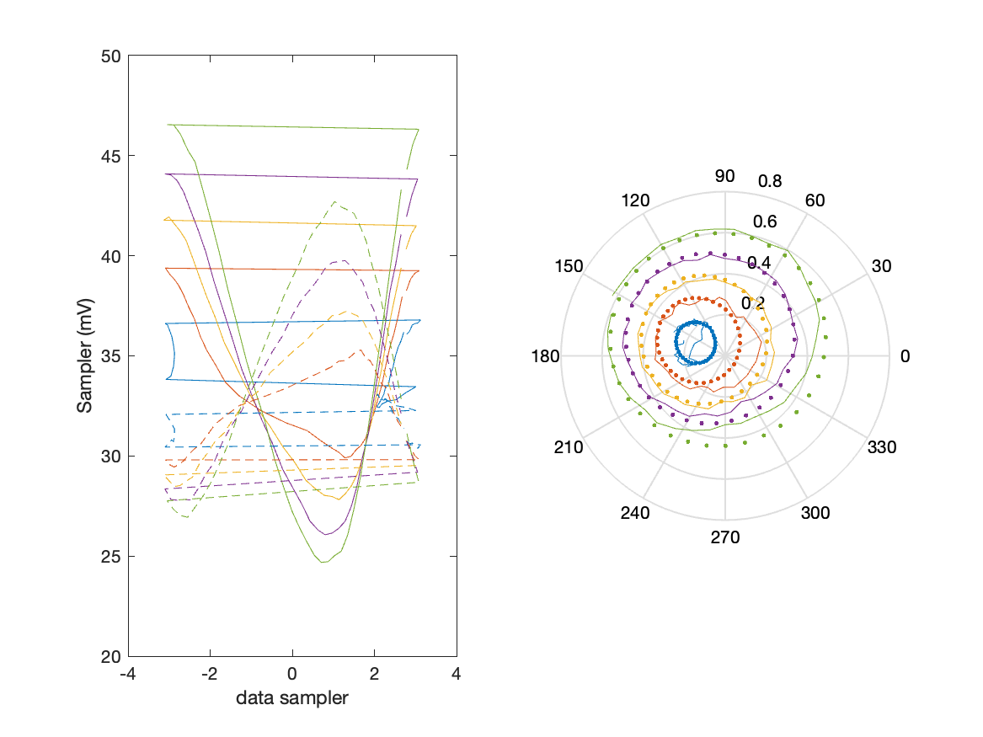
Sampler Performance x^3 Frequency 10.40 GHz, Power 14 dBm
Sampler Av
Sampler 1: 2.306314e+01
Sampler 2: 16.095
Sampler Av3
Sampler 1: 13.459
Sampler 2: 20.934
Sampler Offset (rather than -1)
-1.6622
Goodness Of fit
0.089531

Slide 5
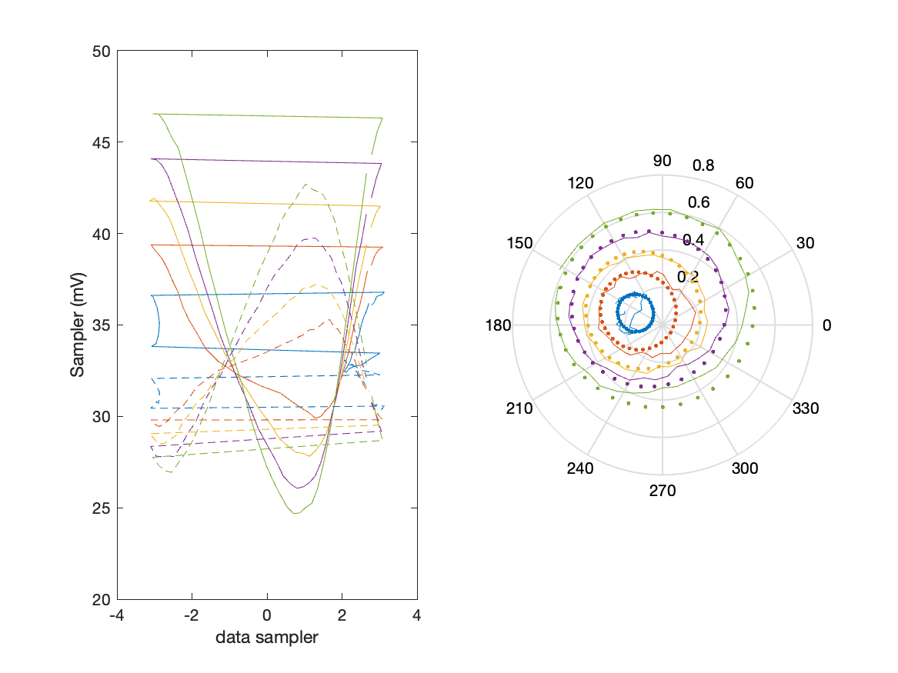
Sampler Performance x^2 x^3 Frequency 10.40 GHz, Power 14 dBm
Sampler Av
Sampler 1: 11.247
Sampler 2: 3.886
Sampler Av3
Sampler 1: -7.912
Sampler 2: 17.052
Sampler Av2
Sampler 1: -18.031
Sampler 2: -19.925
Sampler Offset (rather than -1)
-1.399
Goodness Of fit
0.088988

Slide 6
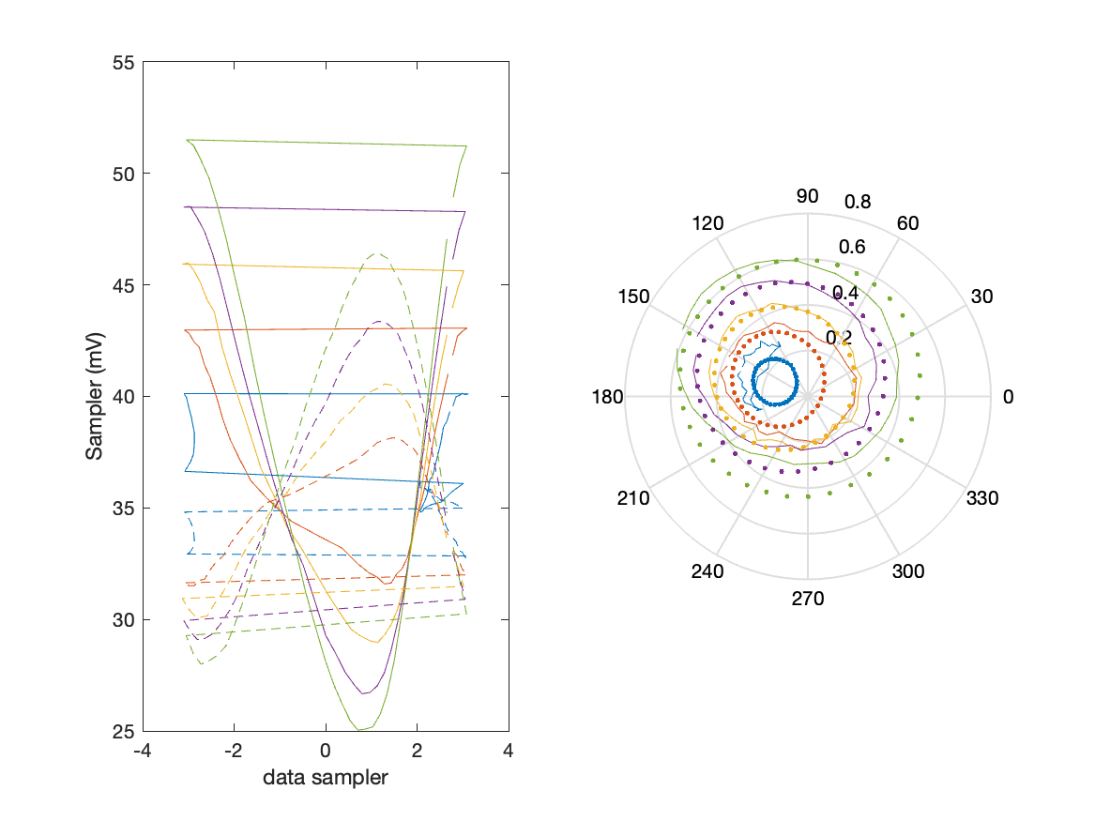
Sampler Performance Frequency 10.40 GHz, Power 16 dBm
Sampler Av
Sampler 1: 31.175
Sampler 2: 48.281
Sampler Offset (rather than -1)
-2.7602
Goodness Of fit
0

Slide 7
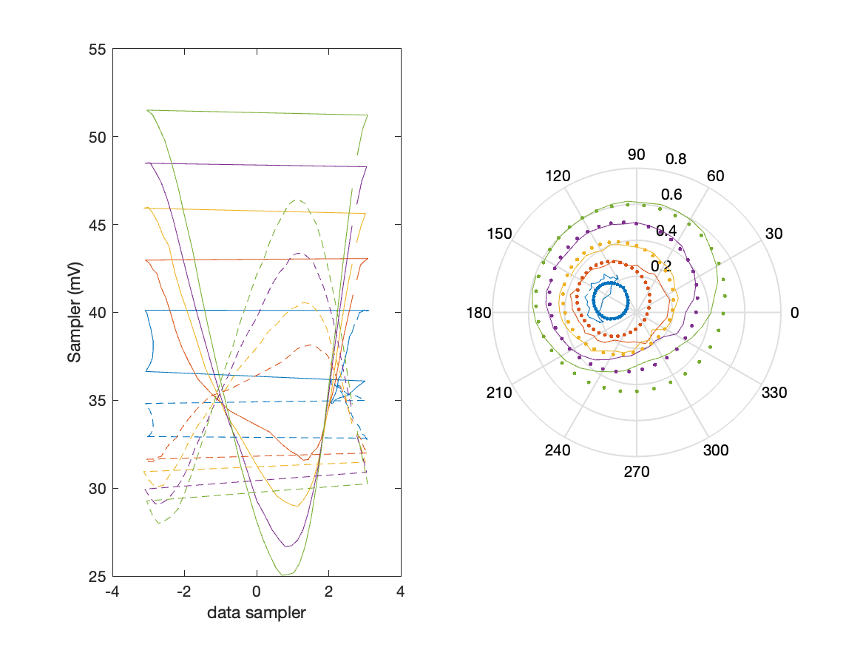
Sampler Performance x^3 Frequency 10.40 GHz, Power 16 dBm
Sampler Av
Sampler 1: 1.790546e+01
Sampler 2: 3.692
Sampler Av3
Sampler 1: 12.803
Sampler 2: 21.073
Sampler Offset (rather than -1)
-1.2353
Goodness Of fit
0

Slide 8

Sampler Performance x^2 x^3 Frequency 10.40 GHz, Power 16 dBm
Sampler Av
Sampler 1: 9.329
Sampler 2: 6.462
Sampler Av3
Sampler 1: 8.125
Sampler 2: 20.464
Sampler Av2
Sampler 1: -14.300
Sampler 2: 2.623
Sampler Offset (rather than -1)
-1.1903
Goodness Of fit
0

Slide 9
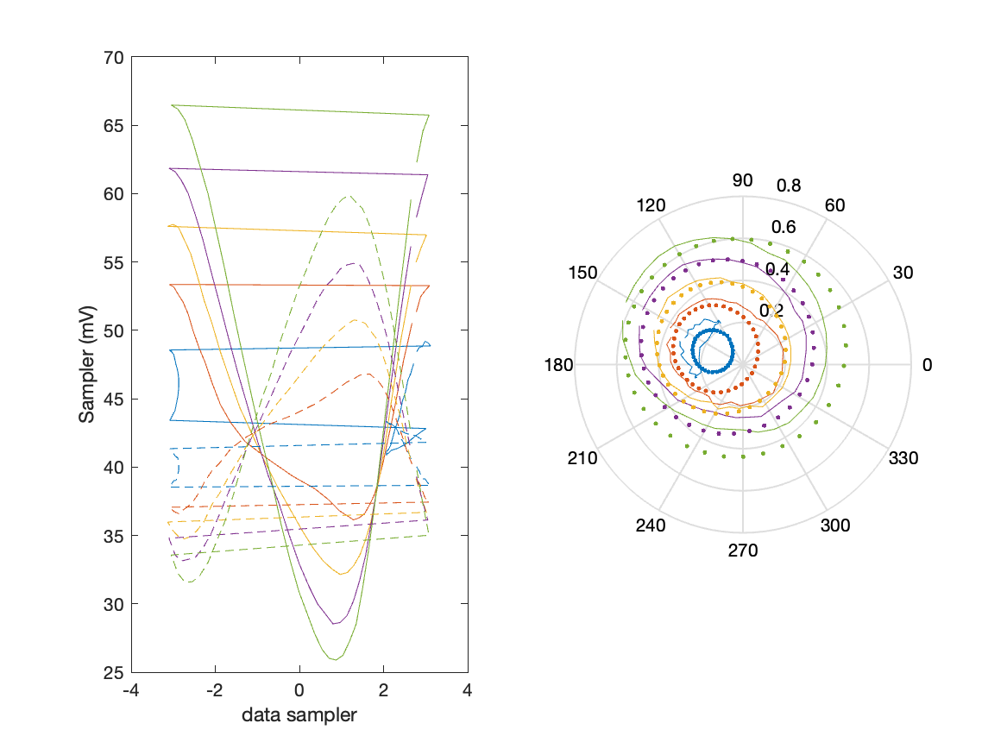
Sampler Performance Frequency 10.40 GHz, Power 18 dBm
Sampler Av
Sampler 1: 19.970
Sampler 2: 30.643
Sampler Offset (rather than -1)
-2.0921
Goodness Of fit
0

Slide 10
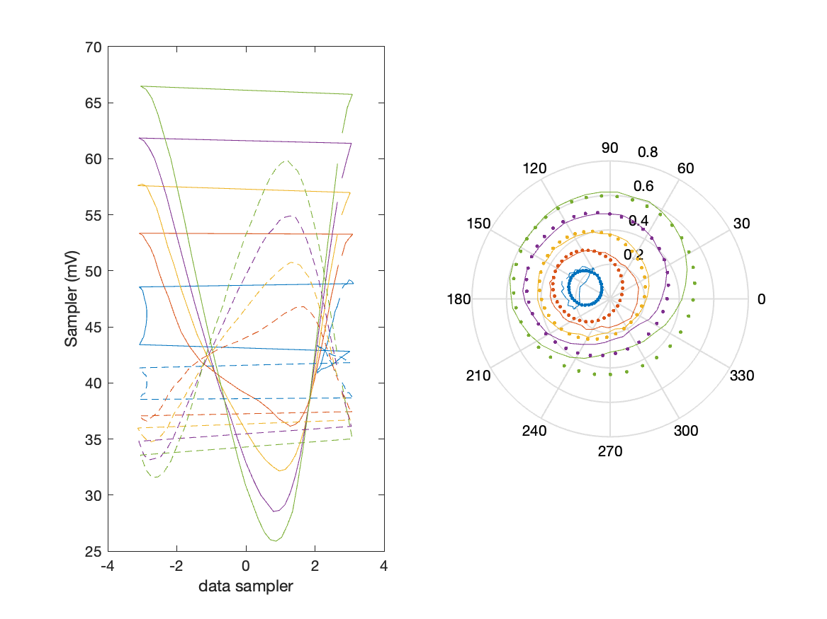
Sampler Performance x^3 Frequency 10.40 GHz, Power 18 dBm
Sampler Av
Sampler 1: 1.229210e+01
Sampler 2: 8.776
Sampler Av3
Sampler 1: 9.322
Sampler 2: 14.325
Sampler Offset (rather than -1)
-1.1394
Goodness Of fit
0

Slide 11
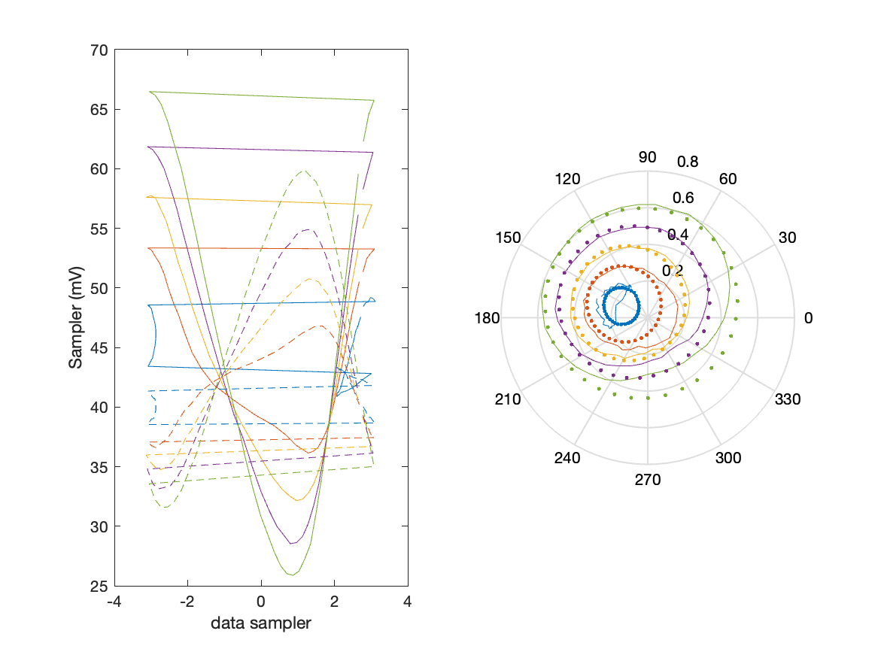
Sampler Performance x^2 x^3 Frequency 10.40 GHz, Power 18 dBm
Sampler Av
Sampler 1: 6.116
Sampler 2: 2.962
Sampler Av3
Sampler 1: -4.767
Sampler 2: 11.697
Sampler Av2
Sampler 1: -11.531
Sampler 2: -12.558
Sampler Offset (rather than -1)
-0.98215
Goodness Of fit
0

Slide 12
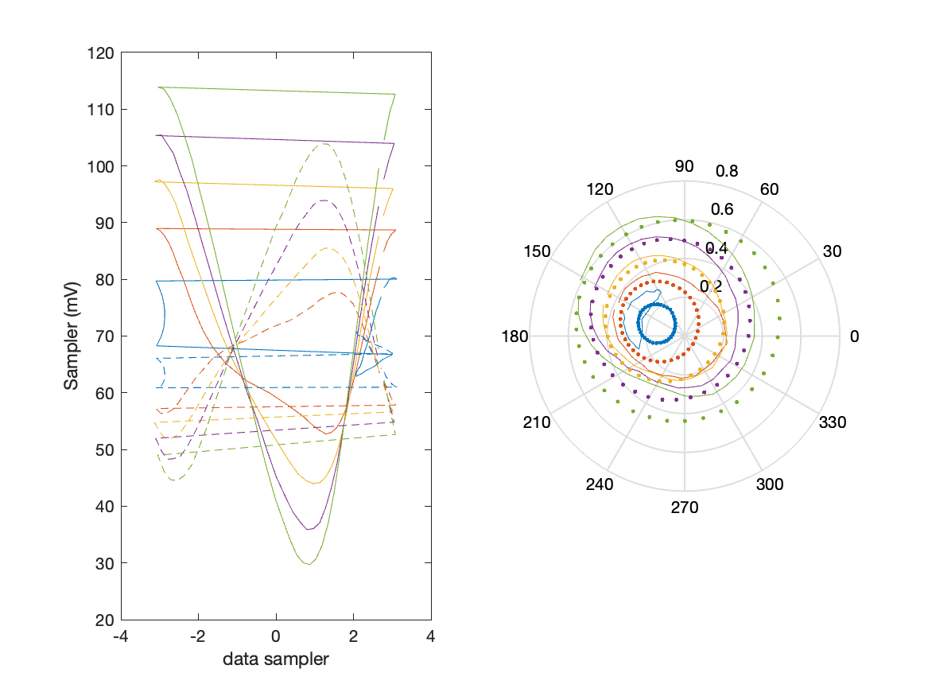
Sampler Performance Frequency 10.40 GHz, Power 22 dBm
Sampler Av
Sampler 1: 9.504
Sampler 2: 14.594
Sampler Offset (rather than -1)
-1.5625
Goodness Of fit
0

Slide 13
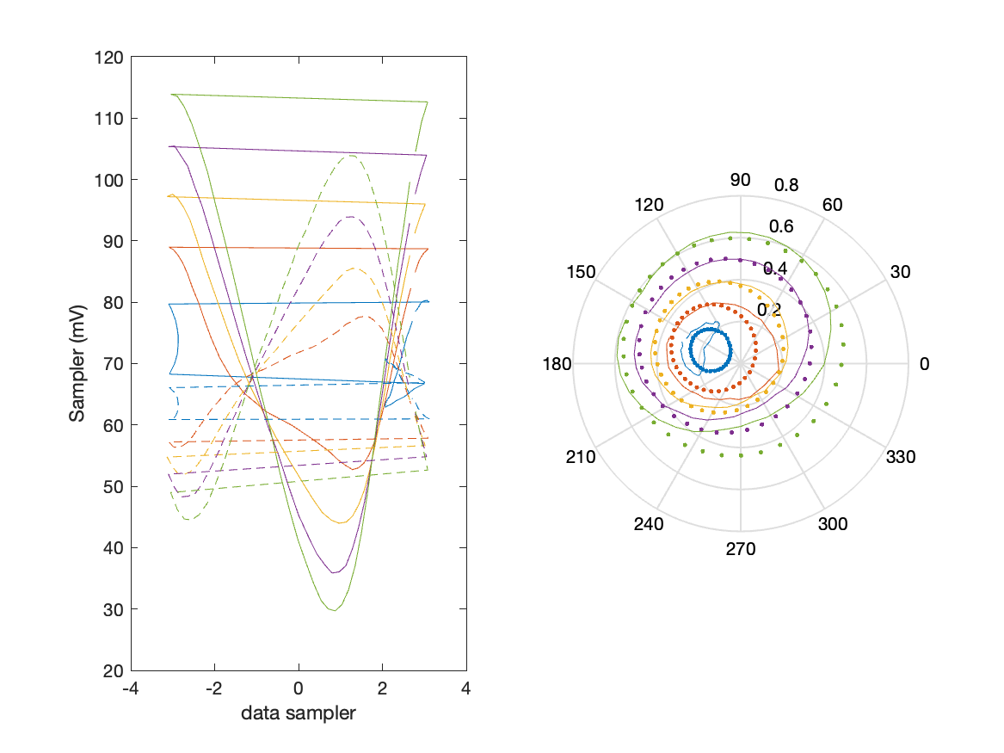
Sampler Performance x^3 Frequency 10.40 GHz, Power 22 dBm
Sampler Av
Sampler 1: 4.426910e+00
Sampler 2: 7.020
Sampler Av3
Sampler 1: 6.198
Sampler 2: 7.003
Sampler Offset (rather than -1)
-0.90916
Goodness Of fit
0

Slide 14

Sampler Performance x^2 x^3 Frequency 10.40 GHz, Power 22 dBm
Sampler Av
Sampler 1: 5.496
Sampler 2: 6.359
Sampler Av3
Sampler 1: 5.860
Sampler 2: 6.666
Sampler Av2
Sampler 1: -0.058
Sampler 2: 3.853
Sampler Offset (rather than -1)
-0.97982
Goodness Of fit
0

Slide 15
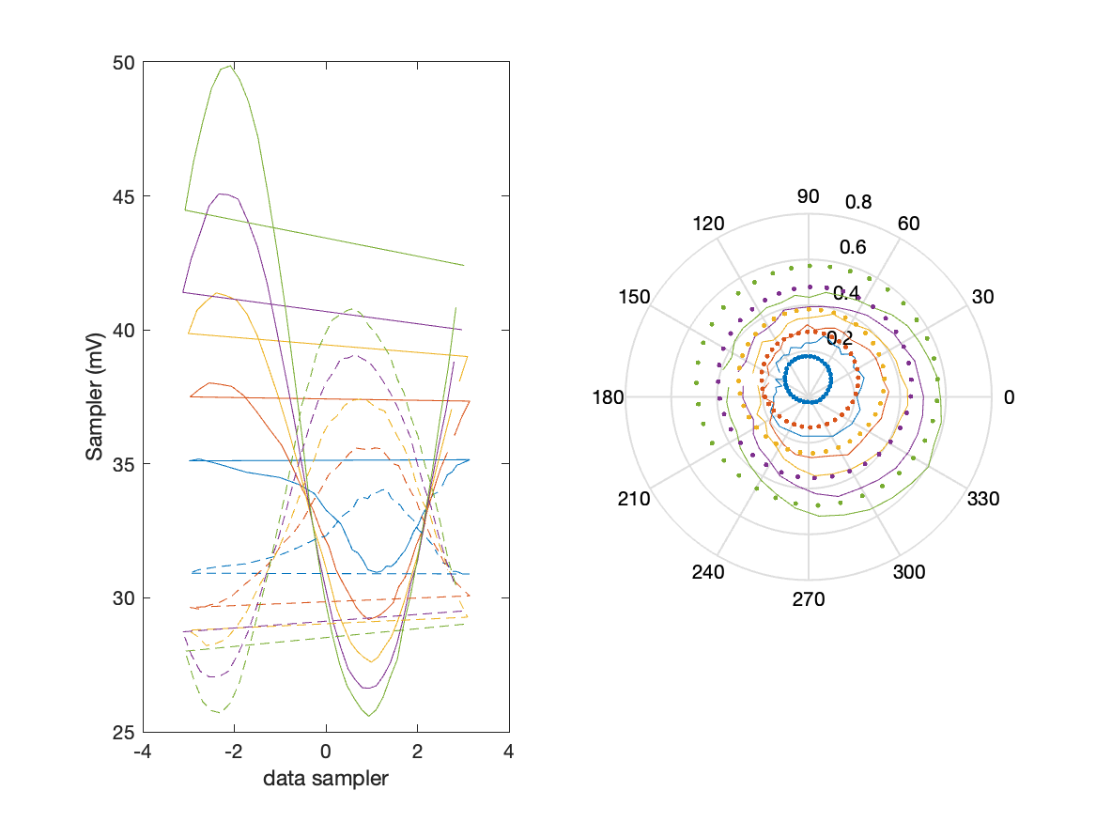
Sampler Performance Frequency 10.90 GHz, Power 14 dBm
Sampler Av
Sampler 1: 26.876
Sampler 2: 50.354
Sampler Offset (rather than -1)
-2.4769
Goodness Of fit
0

Slide 16
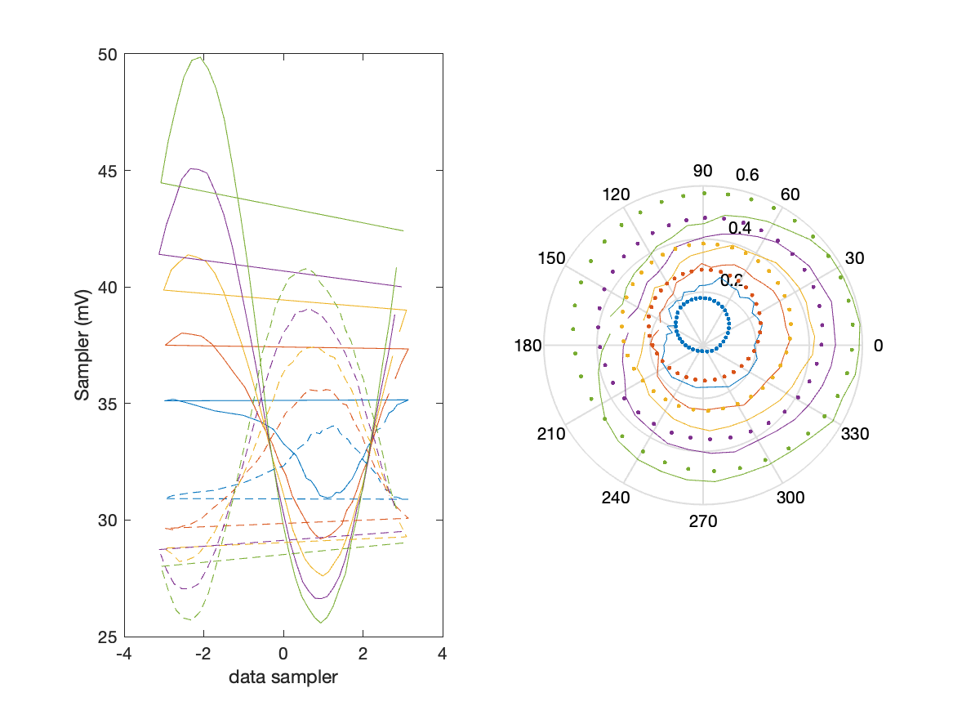
Sampler Performance x^3 Frequency 10.90 GHz, Power 14 dBm
Sampler Av
Sampler 1: 1.160425e+01
Sampler 2: 0.000
Sampler Av3
Sampler 1: 13.592
Sampler 2: 23.304
Sampler Offset (rather than -1)
-0.86839
Goodness Of fit
0

Slide 17

Sampler Performance x^2 x^3 Frequency 10.90 GHz, Power 14 dBm
Sampler Av
Sampler 1: 8.317
Sampler 2: 0.001
Sampler Av3
Sampler 1: 10.208
Sampler 2: 23.212
Sampler Av2
Sampler 1: -10.958
Sampler 2: -0.035
Sampler Offset (rather than -1)
-0.83167
Goodness Of fit
0

Slide 18
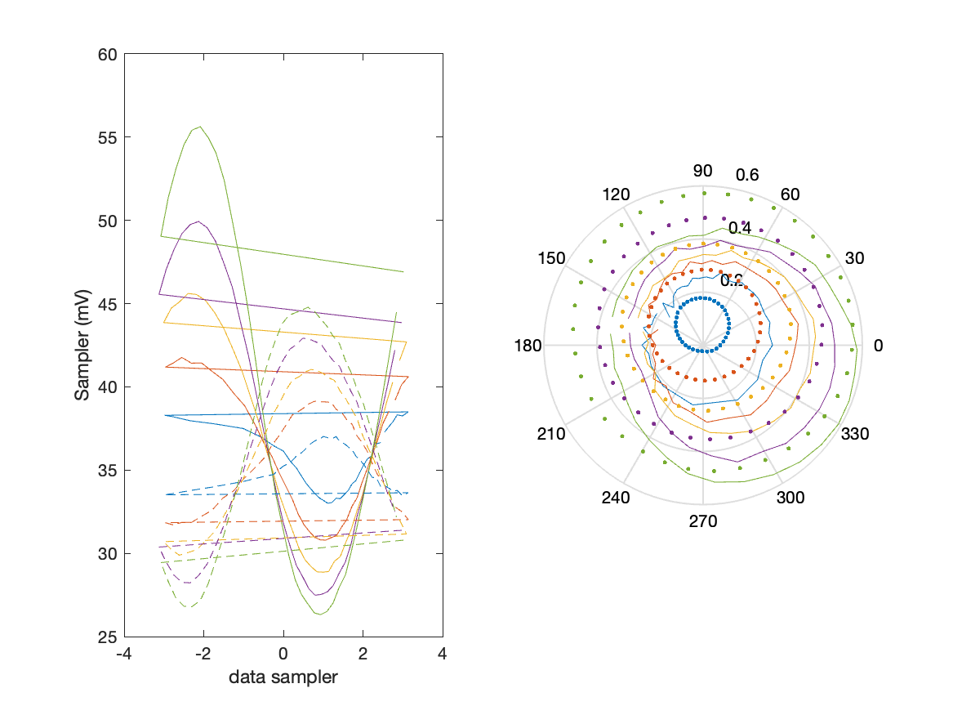
Sampler Performance Frequency 10.90 GHz, Power 16 dBm
Sampler Av
Sampler 1: 23.134
Sampler 2: 43.455
Sampler Offset (rather than -1)
-2.2993
Goodness Of fit
0

Slide 19

Sampler Performance x^3 Frequency 10.90 GHz, Power 16 dBm
Sampler Av
Sampler 1: 8.355269e+00
Sampler 2: 0.000
Sampler Av3
Sampler 1: 12.655
Sampler 2: 20.843
Sampler Offset (rather than -1)
-0.74046
Goodness Of fit
0

Slide 20

Sampler Performance x^2 x^3 Frequency 10.90 GHz, Power 16 dBm
Sampler Av
Sampler 1: 6.347
Sampler 2: 5.533
Sampler Av3
Sampler 1: 11.032
Sampler 2: 19.922
Sampler Av2
Sampler 1: -8.596
Sampler 2: -0.240
Sampler Offset (rather than -1)
-0.87587
Goodness Of fit
0

Slide 21
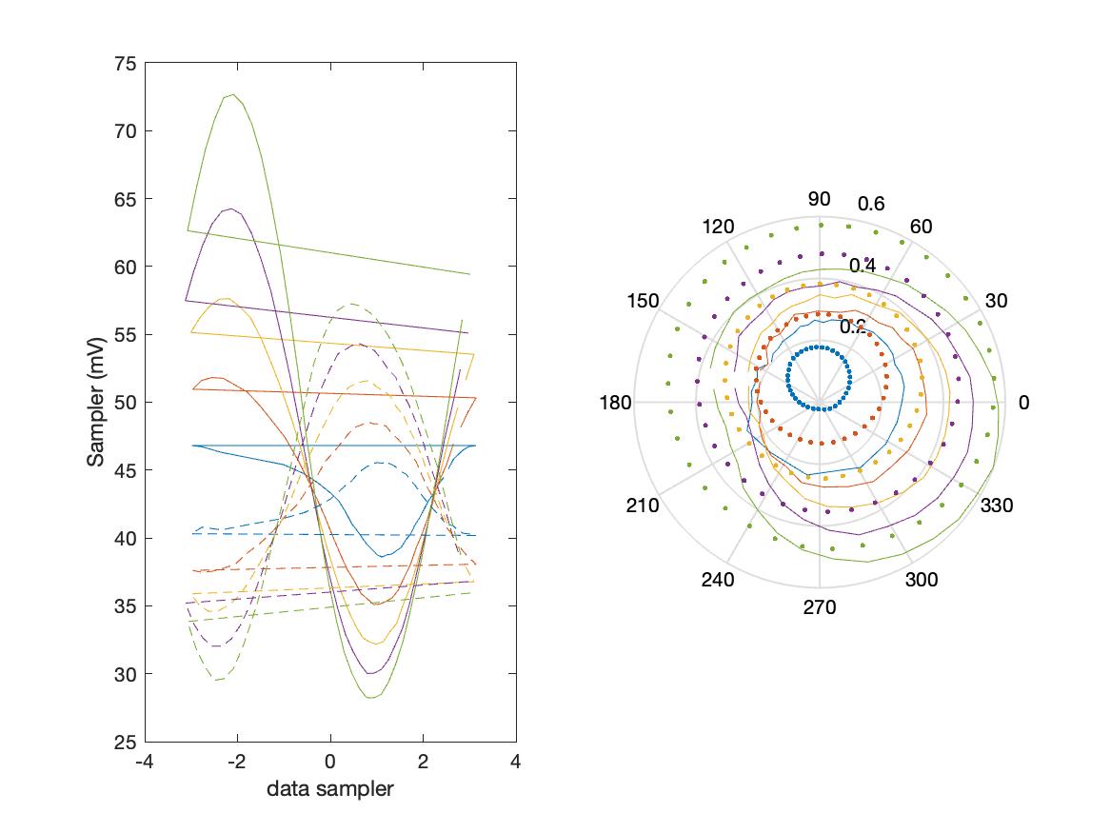
Sampler Performance Frequency 10.90 GHz, Power 18 dBm
Sampler Av
Sampler 1: 15.162
Sampler 2: 28.273
Sampler Offset (rather than -1)
-1.7981
Goodness Of fit
0

Slide 22
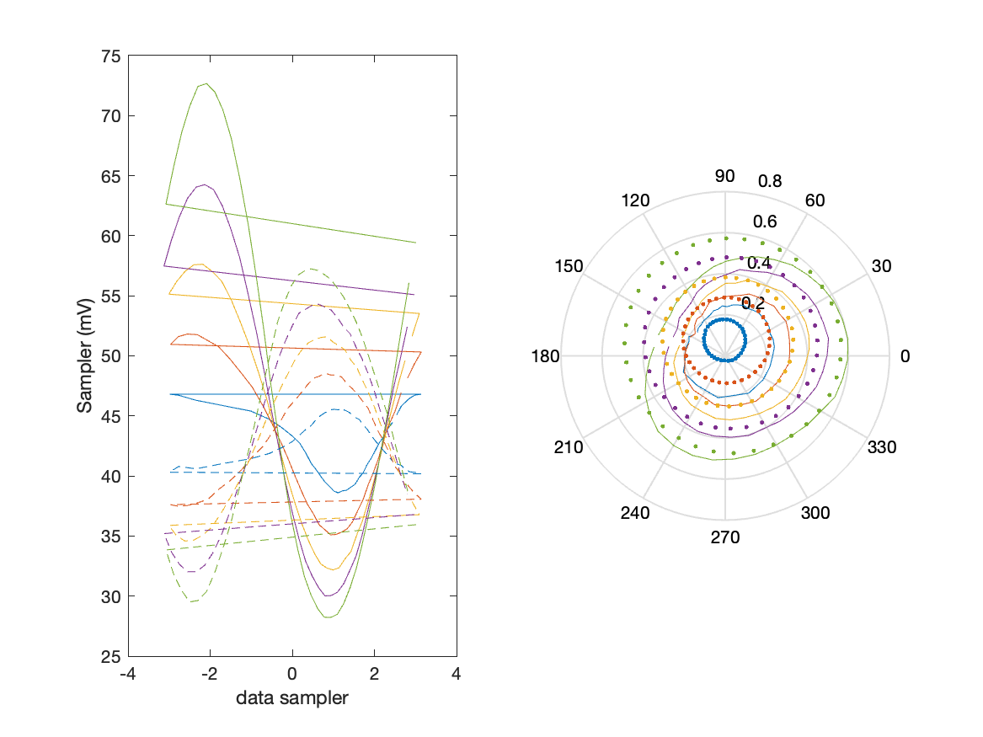
Sampler Performance x^3 Frequency 10.90 GHz, Power 18 dBm
Sampler Av
Sampler 1: 6.920264e+00
Sampler 2: 0.000
Sampler Av3
Sampler 1: 8.641
Sampler 2: 15.729
Sampler Offset (rather than -1)
-0.60535
Goodness Of fit
0

Slide 23
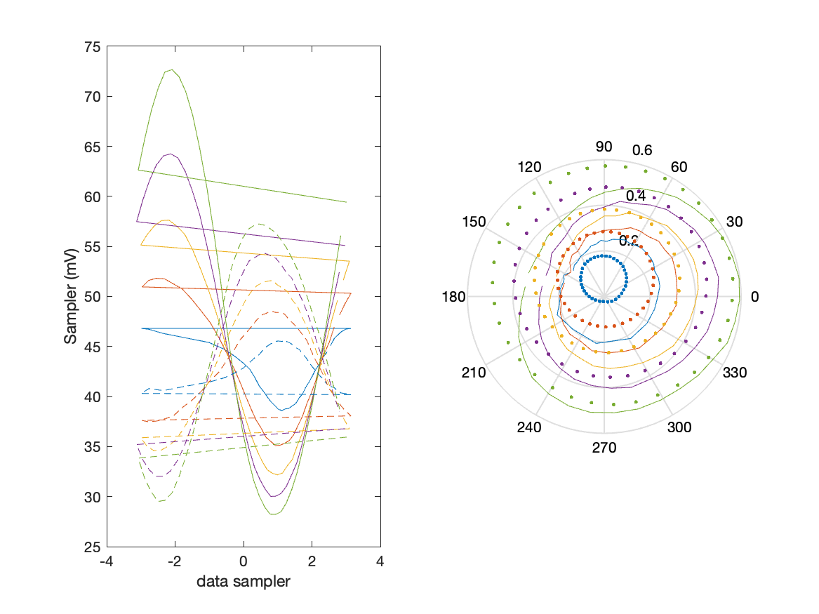
Sampler Performance x^2 x^3 Frequency 10.90 GHz, Power 18 dBm
Sampler Av
Sampler 1: 6.234
Sampler 2: 6.896
Sampler Av3
Sampler 1: 7.231
Sampler 2: 14.368
Sampler Av2
Sampler 1: -6.081
Sampler 2: -0.009
Sampler Offset (rather than -1)
-0.84421
Goodness Of fit
0

Slide 24
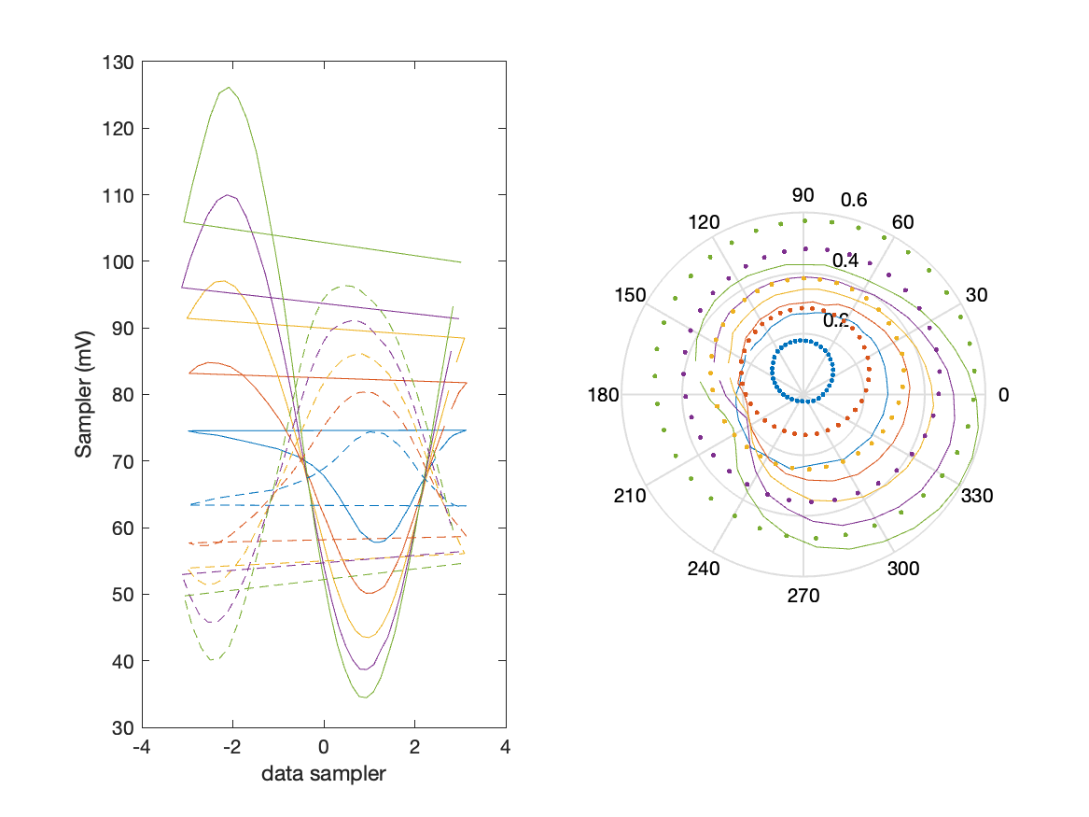
Sampler Performance Frequency 10.90 GHz, Power 22 dBm
Sampler Av
Sampler 1: 7.582
Sampler 2: 14.184
Sampler Offset (rather than -1)
-1.4138
Goodness Of fit
0

Slide 25
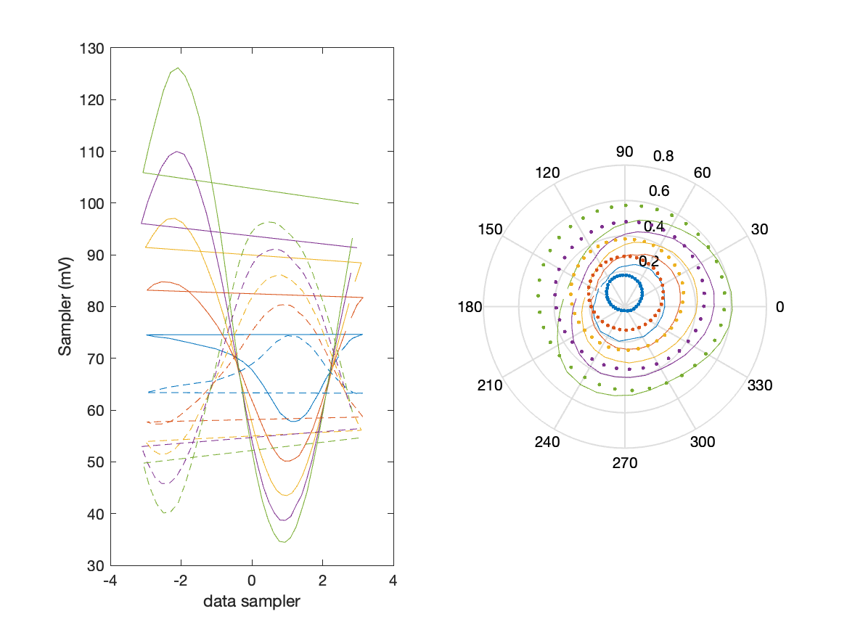
Sampler Performance x^3 Frequency 10.90 GHz, Power 22 dBm
Sampler Av
Sampler 1: 4.305353e+00
Sampler 2: 0.000
Sampler Av3
Sampler 1: 4.480
Sampler 2: 9.197
Sampler Offset (rather than -1)
-0.52372
Goodness Of fit
0

Slide 26
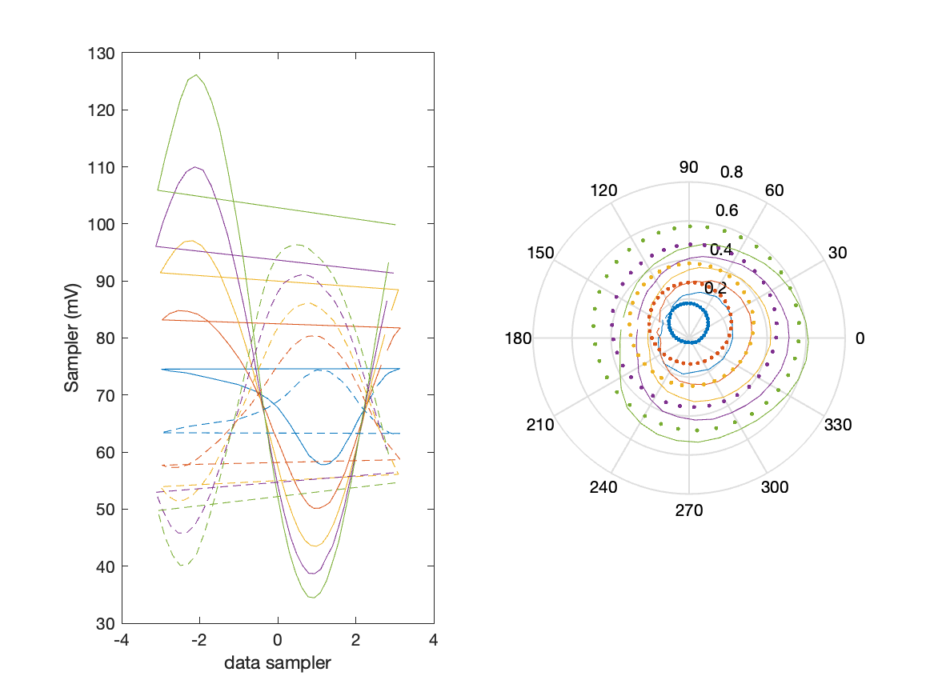
Sampler Performance x^2 x^3 Frequency 10.90 GHz, Power 22 dBm
Sampler Av
Sampler 1: 5.185
Sampler 2: 6.491
Sampler Av3
Sampler 1: 4.743
Sampler 2: 7.960
Sampler Av2
Sampler 1: -1.379
Sampler 2: 0.010
Sampler Offset (rather than -1)
-0.95573
Goodness Of fit
0

Slide 27
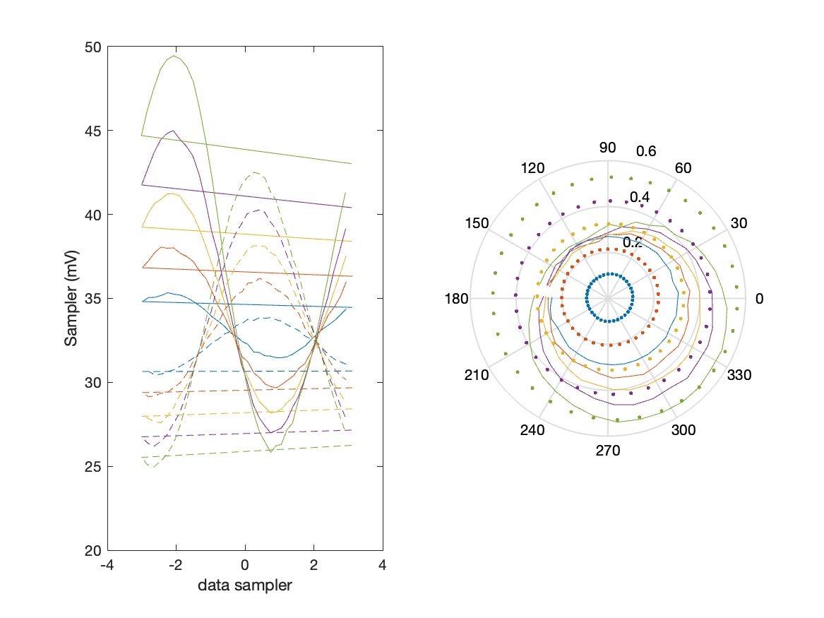
Sampler Performance Frequency 11.40 GHz, Power 14 dBm
Sampler Av
Sampler 1: 17.400
Sampler 2: 23.932
Sampler Offset (rather than -1)
-1.2744
Goodness Of fit
0

Slide 28
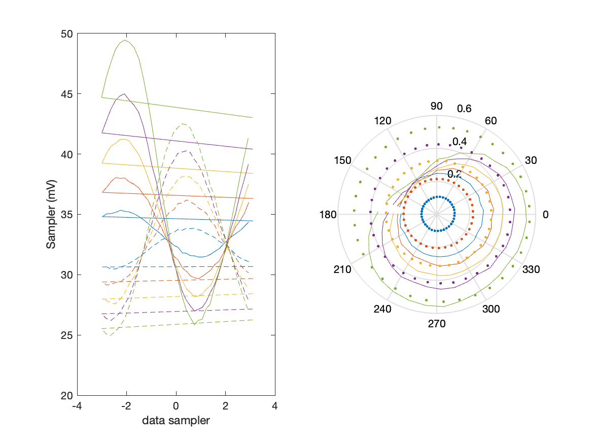
Sampler Performance x^3 Frequency 11.40 GHz, Power 14 dBm
Sampler Av
Sampler 1: 2.263211e-11
Sampler 2: 0.000
Sampler Av3
Sampler 1: 15.741
Sampler 2: 18.721
Sampler Offset (rather than -1)
-0.30238
Goodness Of fit
0

Slide 29
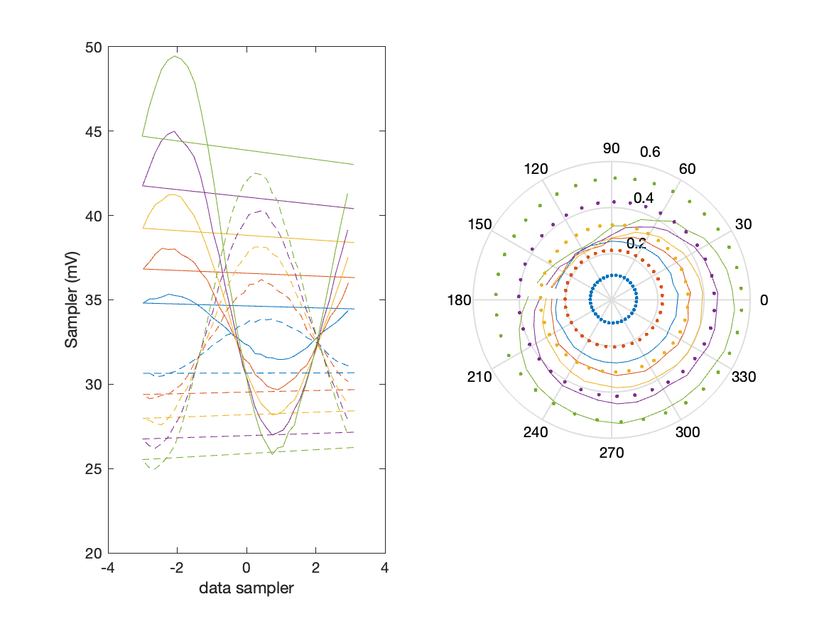
Sampler Performance x^2 x^3 Frequency 11.40 GHz, Power 14 dBm
Sampler Av
Sampler 1: 8.906
Sampler 2: 0.013
Sampler Av3
Sampler 1: 11.852
Sampler 2: 18.366
Sampler Av2
Sampler 1: -0.342
Sampler 2: -0.770
Sampler Offset (rather than -1)
-0.49923
Goodness Of fit
0

Slide 30
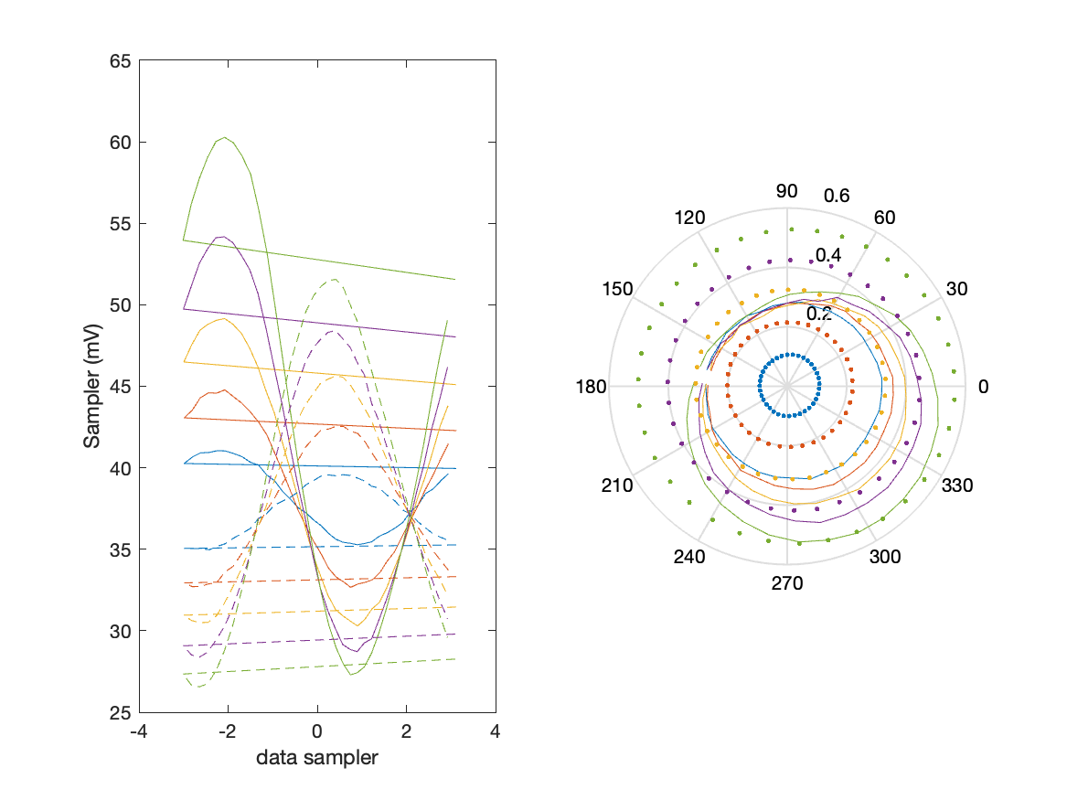
Sampler Performance Frequency 11.40 GHz, Power 16 dBm
Sampler Av
Sampler 1: 11.574
Sampler 2: 15.924
Sampler Offset (rather than -1)
-0.94864
Goodness Of fit
0

Slide 31
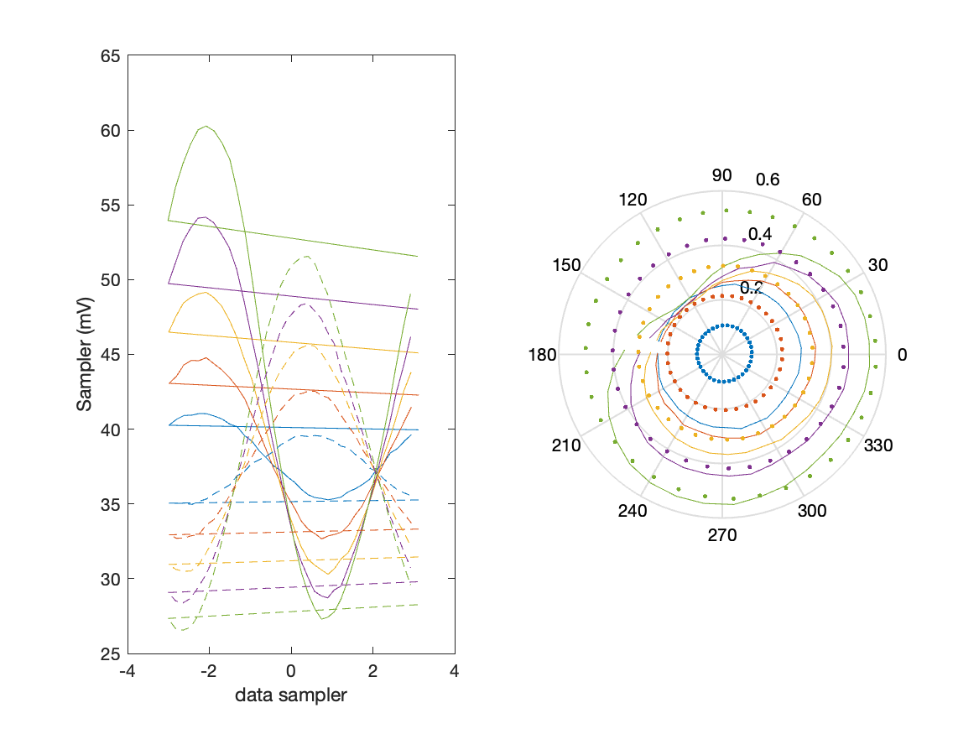
Sampler Performance x^3 Frequency 11.40 GHz, Power 16 dBm
Sampler Av
Sampler 1: 2.288032e-14
Sampler 2: 0.000
Sampler Av3
Sampler 1: 12.470
Sampler 2: 14.852
Sampler Offset (rather than -1)
-0.21113
Goodness Of fit
0

Slide 32

Sampler Performance x^2 x^3 Frequency 11.40 GHz, Power 16 dBm
Sampler Av
Sampler 1: 6.879
Sampler 2: 7.167
Sampler Av3
Sampler 1: 10.599
Sampler 2: 13.572
Sampler Av2
Sampler 1: -0.197
Sampler 2: -0.150
Sampler Offset (rather than -1)
-0.6605
Goodness Of fit
0

Slide 33
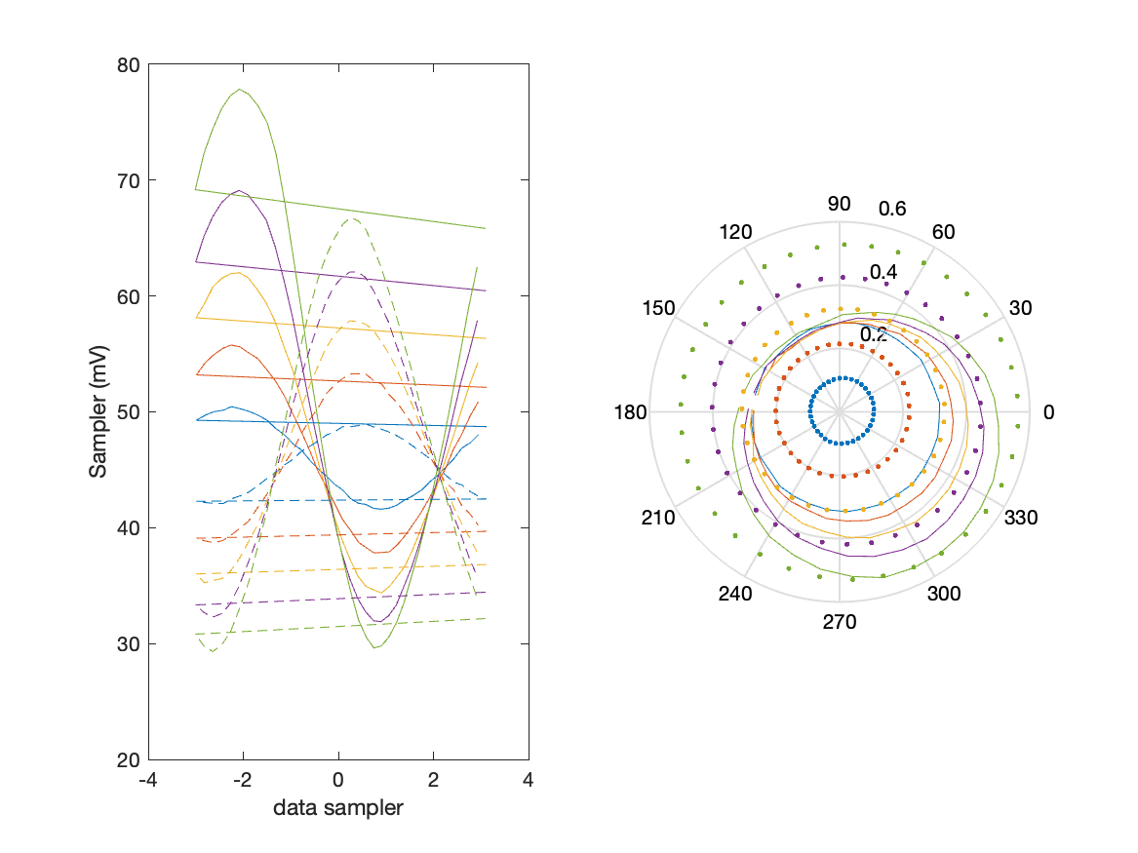
Sampler Performance Frequency 11.40 GHz, Power 18 dBm
Sampler Av
Sampler 1: 7.814
Sampler 2: 10.618
Sampler Offset (rather than -1)
-0.75512
Goodness Of fit
0

Slide 34
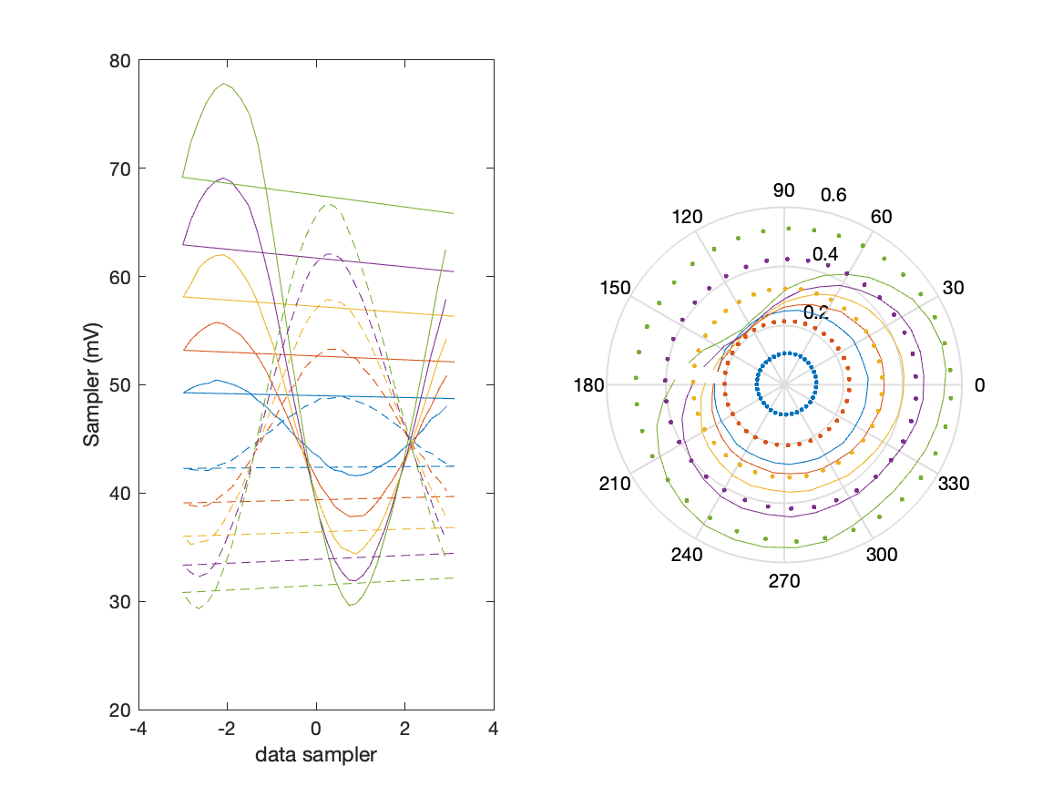
Sampler Performance x^3 Frequency 11.40 GHz, Power 18 dBm
Sampler Av
Sampler 1: 1.833632e-09
Sampler 2: 0.000
Sampler Av3
Sampler 1: 9.433
Sampler 2: 11.187
Sampler Offset (rather than -1)
-0.1491
Goodness Of fit
0

Slide 35
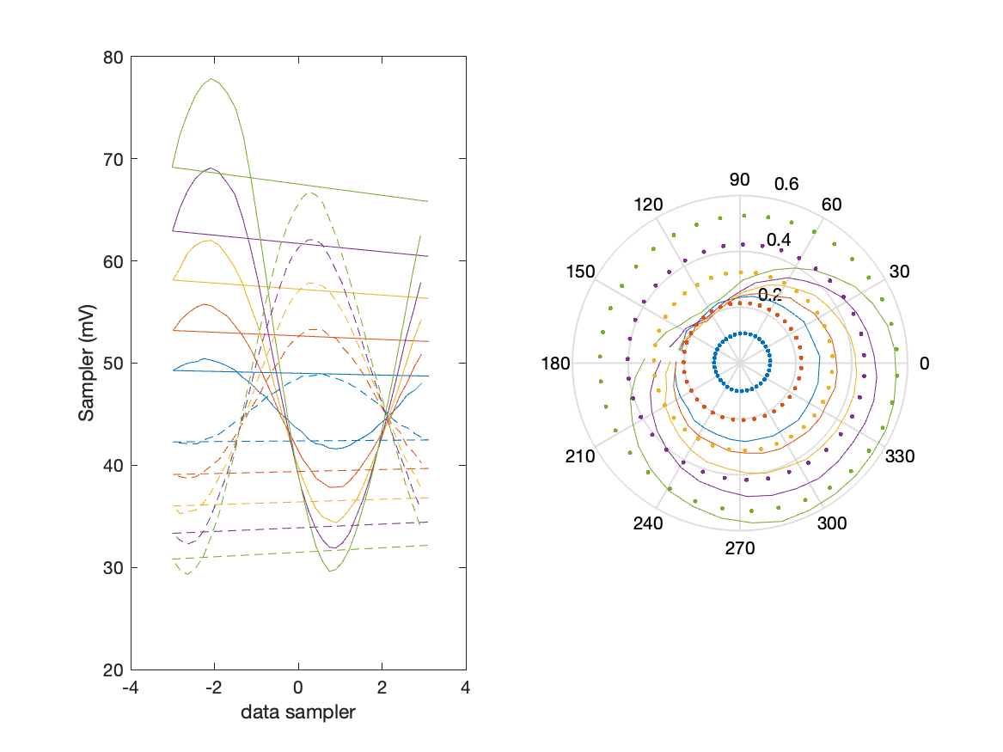
Sampler Performance x^2 x^3 Frequency 11.40 GHz, Power 18 dBm
Sampler Av
Sampler 1: 6.787
Sampler 2: 7.403
Sampler Av3
Sampler 1: 7.111
Sampler 2: 9.455
Sampler Av2
Sampler 1: -0.013
Sampler 2: 0.014
Sampler Offset (rather than -1)
-0.69909
Goodness Of fit
0

Slide 36
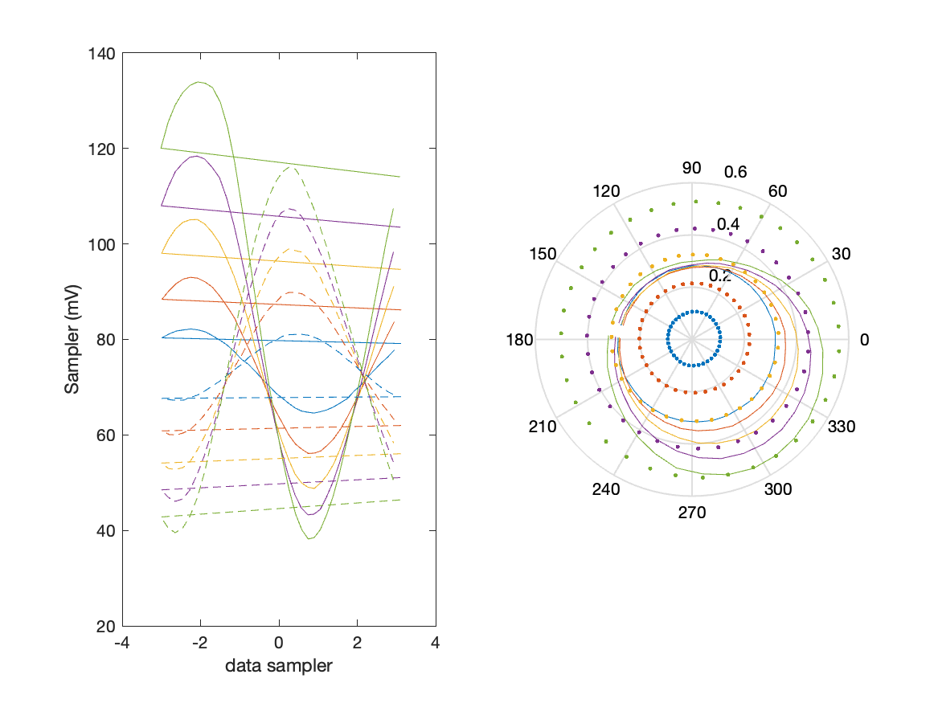
Sampler Performance Frequency 11.40 GHz, Power 22 dBm
Sampler Av
Sampler 1: 3.892
Sampler 2: 5.259
Sampler Offset (rather than -1)
-0.58551
Goodness Of fit
0

Slide 37
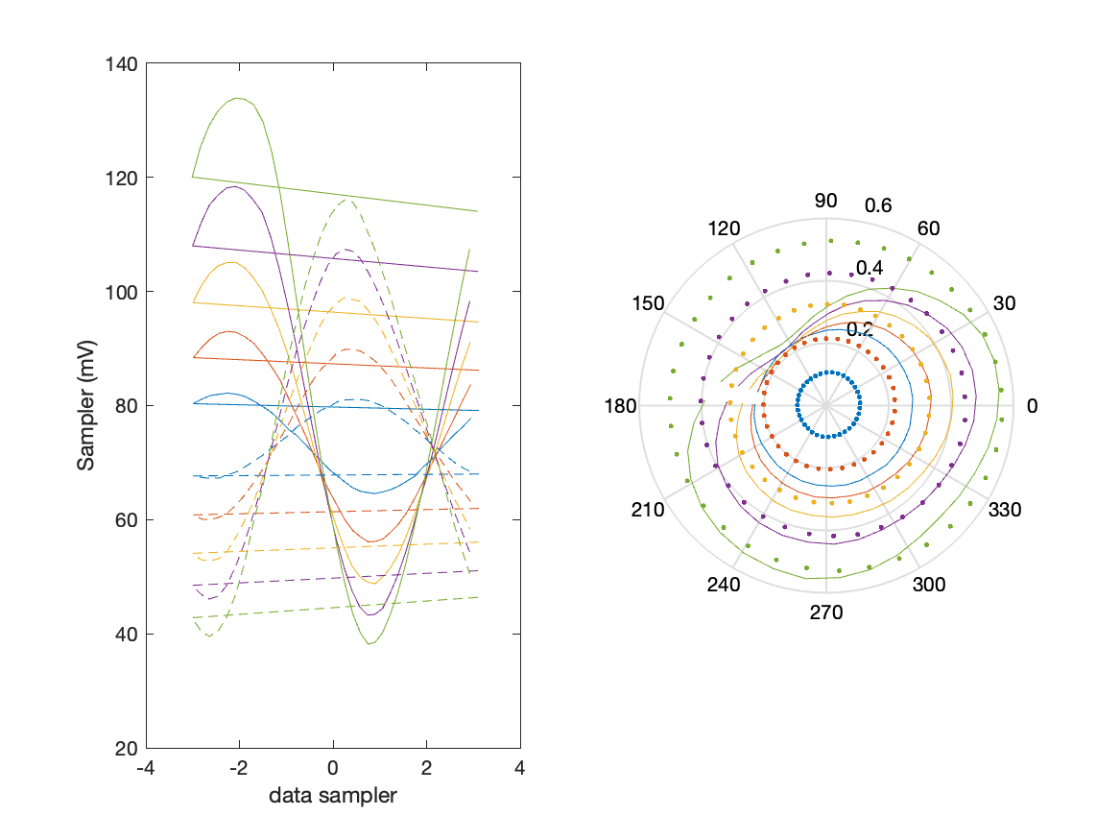
Sampler Performance x^3 Frequency 11.40 GHz, Power 22 dBm
Sampler Av
Sampler 1: 1.140428e-10
Sampler 2: 0.000
Sampler Av3
Sampler 1: 5.365
Sampler 2: 6.333
Sampler Offset (rather than -1)
-0.10377
Goodness Of fit
0

Slide 38
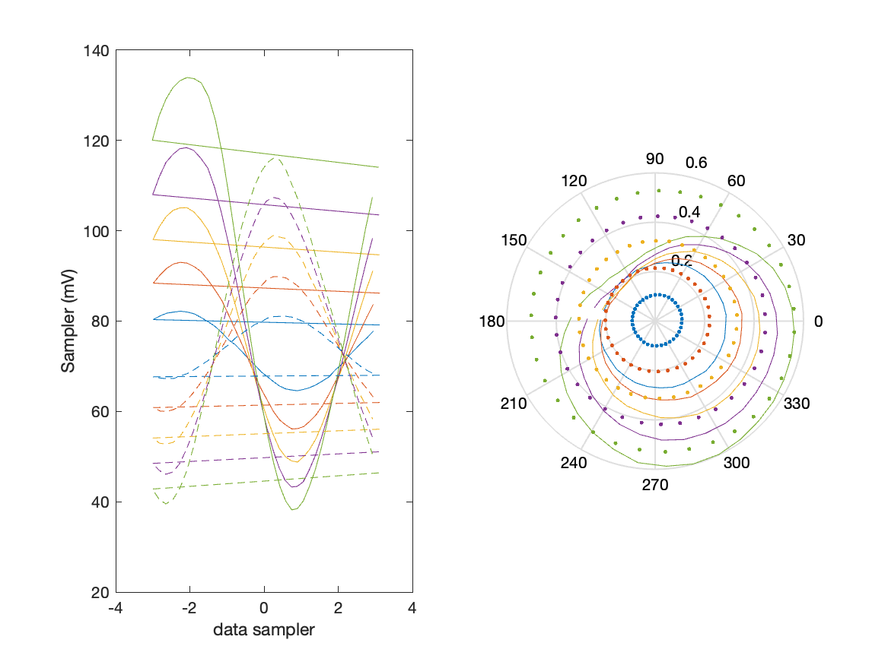
Sampler Performance x^2 x^3 Frequency 11.40 GHz, Power 22 dBm
Sampler Av
Sampler 1: 2.781
Sampler 2: 5.017
Sampler Av3
Sampler 1: 4.661
Sampler 2: 4.676
Sampler Av2
Sampler 1: -0.035
Sampler 2: -0.056
Sampler Offset (rather than -1)
-0.59499
Goodness Of fit
0

Slide 39
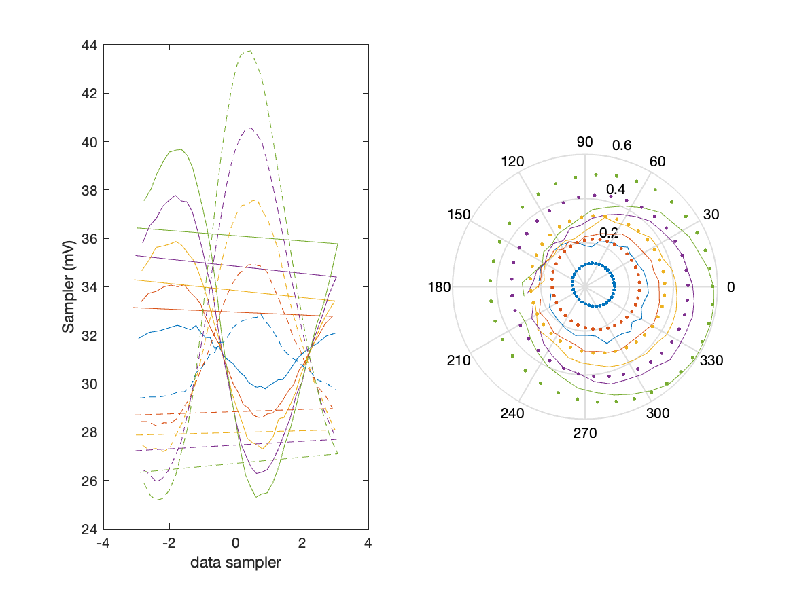
Sampler Performance Frequency 11.90 GHz, Power 14 dBm
Sampler Av
Sampler 1: 32.812
Sampler 2: 31.382
Sampler Offset (rather than -1)
-1.9431
Goodness Of fit
0

Slide 40
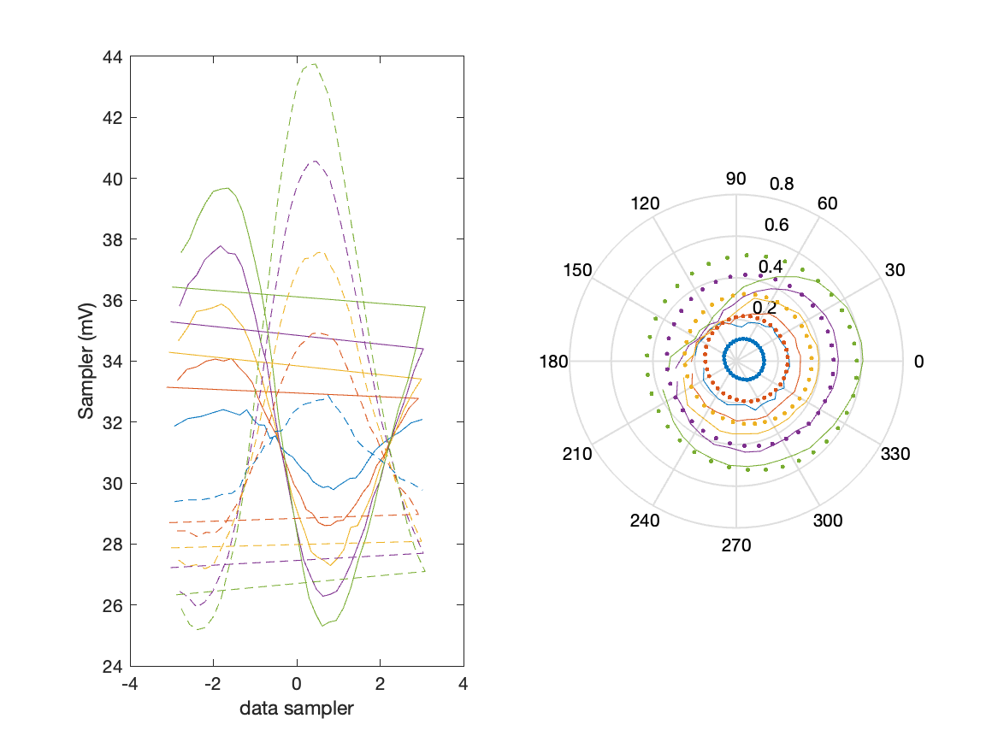
Sampler Performance x^3 Frequency 11.90 GHz, Power 14 dBm
Sampler Av
Sampler 1: 1.080165e-08
Sampler 2: 2.298
Sampler Av3
Sampler 1: 20.768
Sampler 2: 19.425
Sampler Offset (rather than -1)
-0.51831
Goodness Of fit
0

Slide 41

Sampler Performance x^2 x^3 Frequency 11.90 GHz, Power 14 dBm
Sampler Av
Sampler 1: 5.244
Sampler 2: 8.435
Sampler Av3
Sampler 1: 19.470
Sampler 2: 17.698
Sampler Av2
Sampler 1: -0.314
Sampler 2: -1.458
Sampler Offset (rather than -1)
-0.76936
Goodness Of fit
0

Slide 42
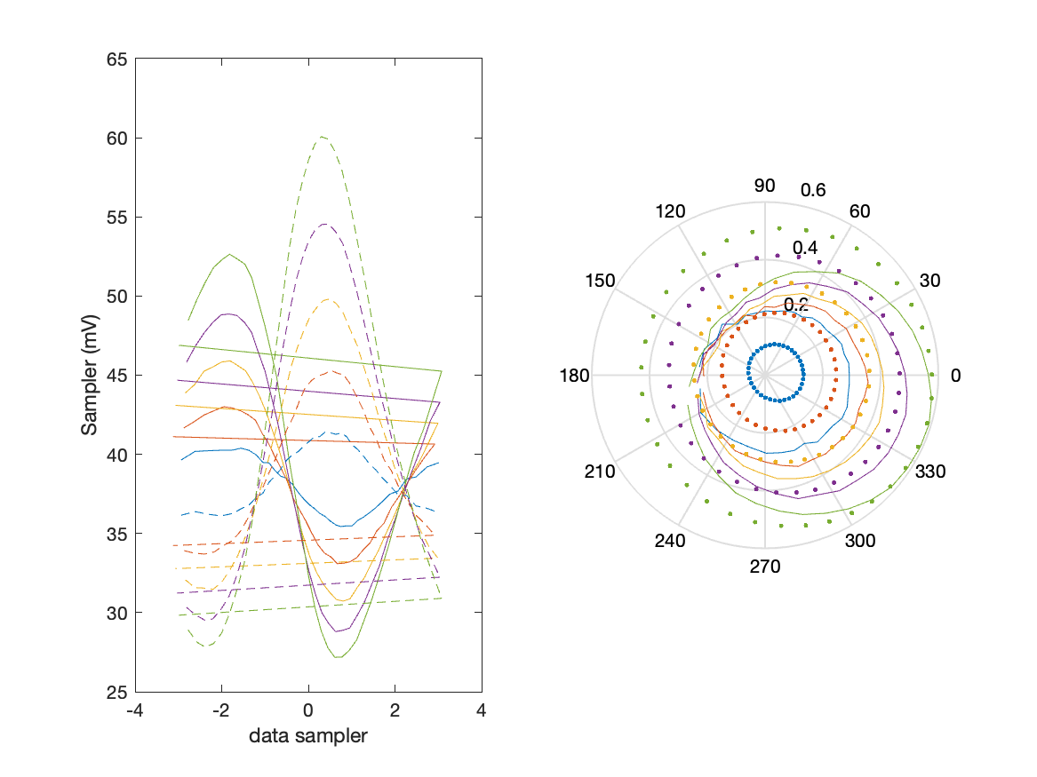
Sampler Performance Frequency 11.90 GHz, Power 16 dBm
Sampler Av
Sampler 1: 17.986
Sampler 2: 17.763
Sampler Offset (rather than -1)
-1.3025
Goodness Of fit
0

Slide 43
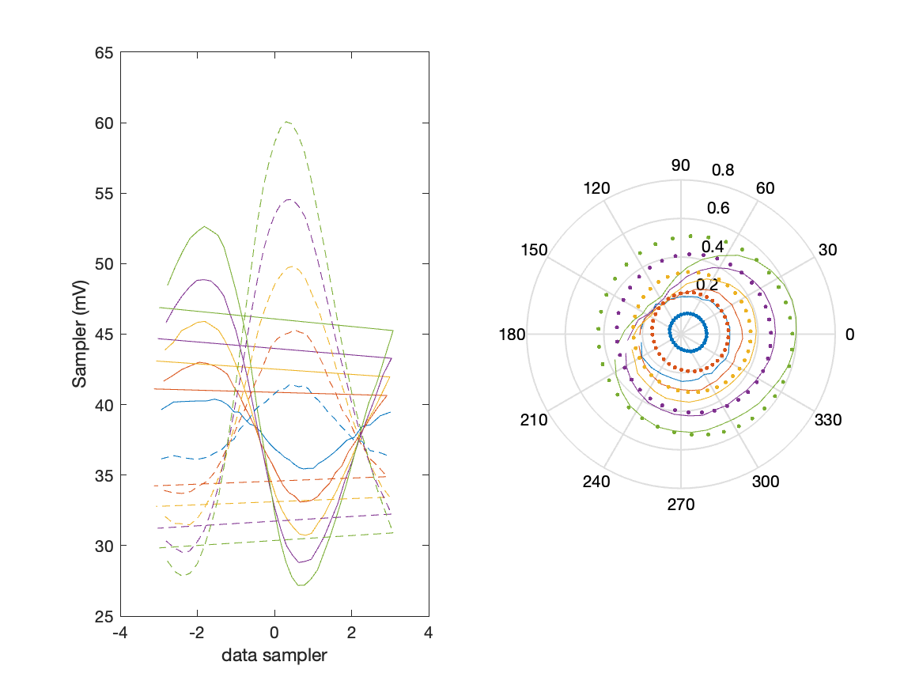
Sampler Performance x^3 Frequency 11.90 GHz, Power 16 dBm
Sampler Av
Sampler 1: 3.890034e-14
Sampler 2: 3.256
Sampler Av3
Sampler 1: 14.720
Sampler 2: 12.902
Sampler Offset (rather than -1)
-0.37385
Goodness Of fit
0

Slide 44

Sampler Performance x^2 x^3 Frequency 11.90 GHz, Power 16 dBm
Sampler Av
Sampler 1: 7.739
Sampler 2: 8.556
Sampler Av3
Sampler 1: 12.680
Sampler 2: 11.511
Sampler Av2
Sampler 1: -0.129
Sampler 2: -0.033
Sampler Offset (rather than -1)
-0.77118
Goodness Of fit
0

Slide 45
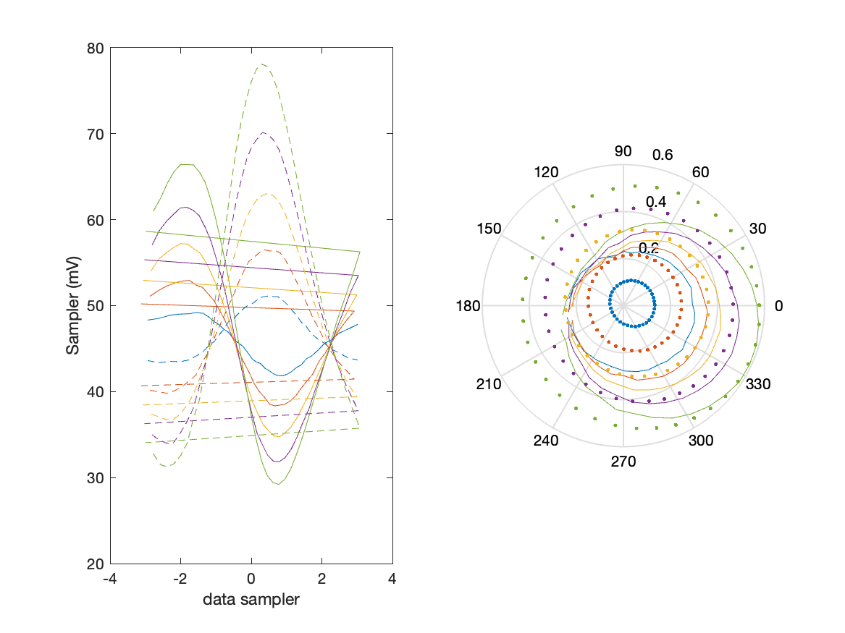
Sampler Performance Frequency 11.90 GHz, Power 18 dBm
Sampler Av
Sampler 1: 12.173
Sampler 2: 12.272
Sampler Offset (rather than -1)
-1.0636
Goodness Of fit
0

Slide 46
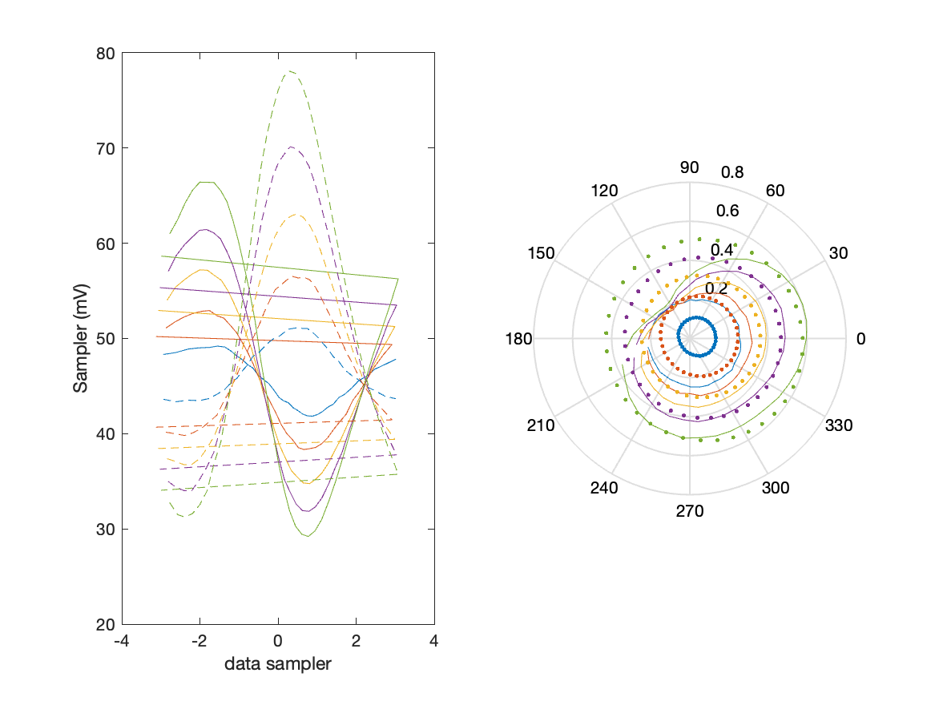
Sampler Performance x^3 Frequency 11.90 GHz, Power 18 dBm
Sampler Av
Sampler 1: 1.316640e-08
Sampler 2: 3.828
Sampler Av3
Sampler 1: 11.383
Sampler 2: 9.171
Sampler Offset (rather than -1)
-0.34968
Goodness Of fit
0

Slide 47

Sampler Performance x^2 x^3 Frequency 11.90 GHz, Power 18 dBm
Sampler Av
Sampler 1: 5.714
Sampler 2: 7.806
Sampler Av3
Sampler 1: 10.039
Sampler 2: 8.143
Sampler Av2
Sampler 1: -0.132
Sampler 2: 0.048
Sampler Offset (rather than -1)
-0.72957
Goodness Of fit
0

Slide 48
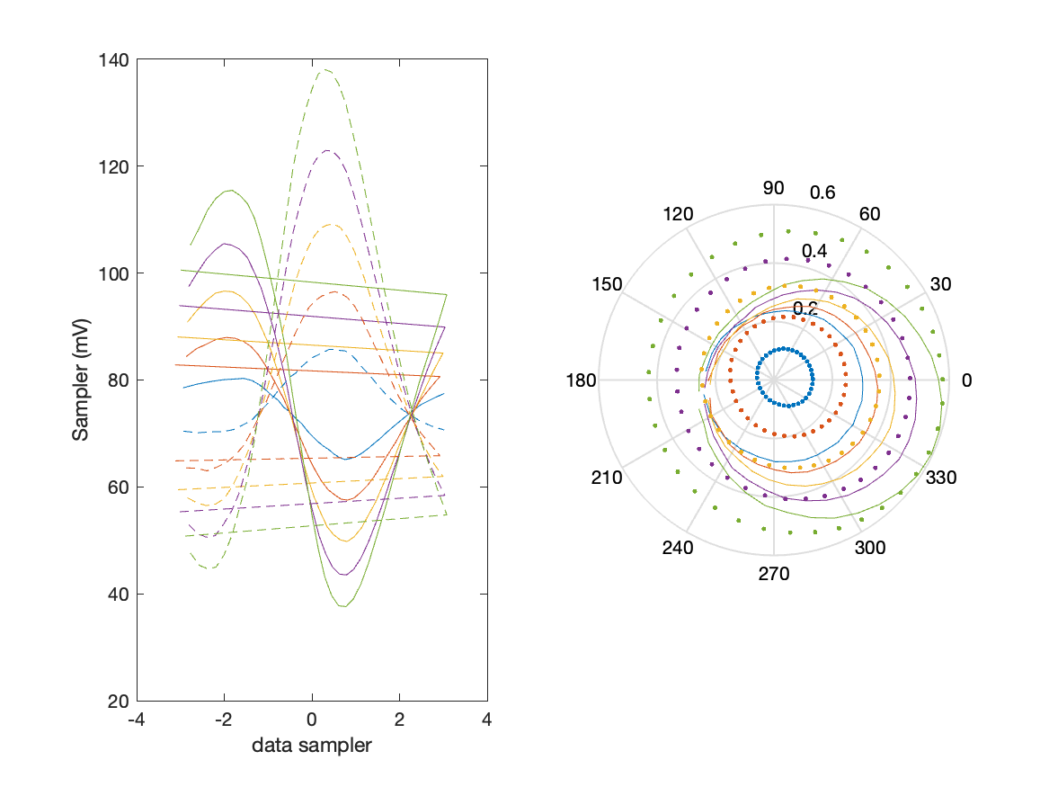
Sampler Performance Frequency 11.90 GHz, Power 22 dBm
Sampler Av
Sampler 1: 5.898
Sampler 2: 6.219
Sampler Offset (rather than -1)
-0.84116
Goodness Of fit
0

Slide 49
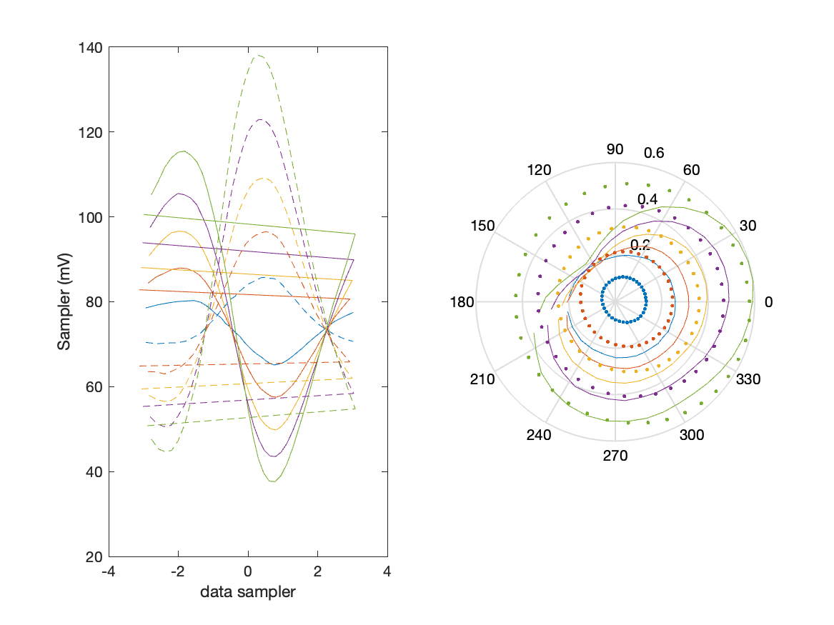
Sampler Performance x^3 Frequency 11.90 GHz, Power 22 dBm
Sampler Av
Sampler 1: 1.965442e-10
Sampler 2: 2.757
Sampler Av3
Sampler 1: 6.482
Sampler 2: 4.700
Sampler Offset (rather than -1)
-0.31857
Goodness Of fit
0

Slide 50
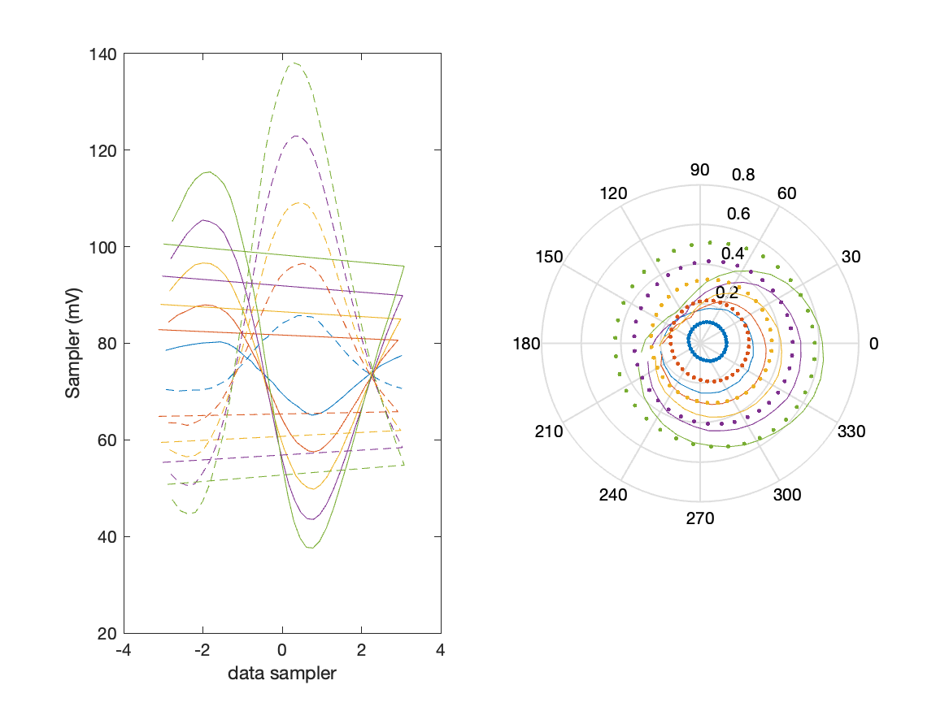
Sampler Performance x^2 x^3 Frequency 11.90 GHz, Power 22 dBm
Sampler Av
Sampler 1: 5.669
Sampler 2: 5.708
Sampler Av3
Sampler 1: 4.581
Sampler 2: 4.066
Sampler Av2
Sampler 1: -0.019
Sampler 2: 0.091
Sampler Offset (rather than -1)
-0.87599
Goodness Of fit
0

Slide 51
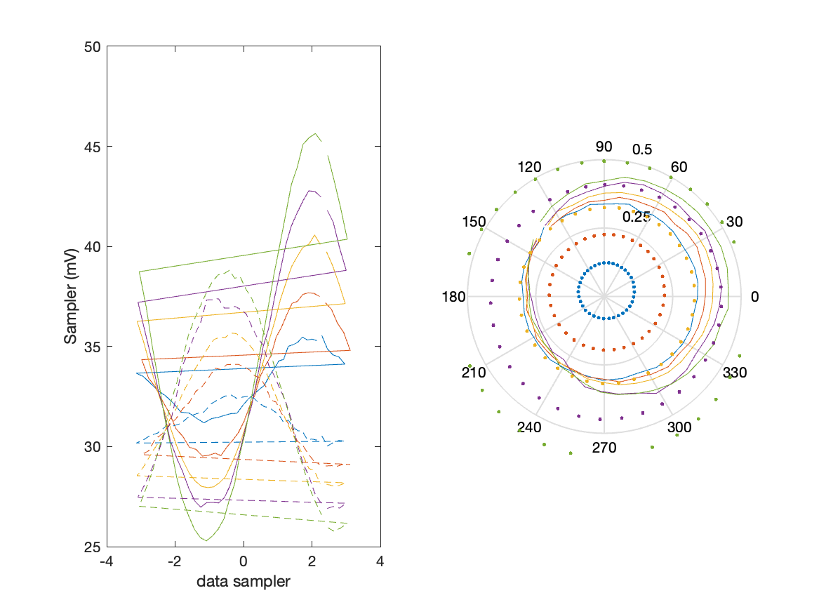
Sampler Performance Frequency 8.90 GHz, Power 14 dBm
Sampler Av
Sampler 1: 9.424
Sampler 2: 18.846
Sampler Offset (rather than -1)
-0.79821
Goodness Of fit
0

Slide 52
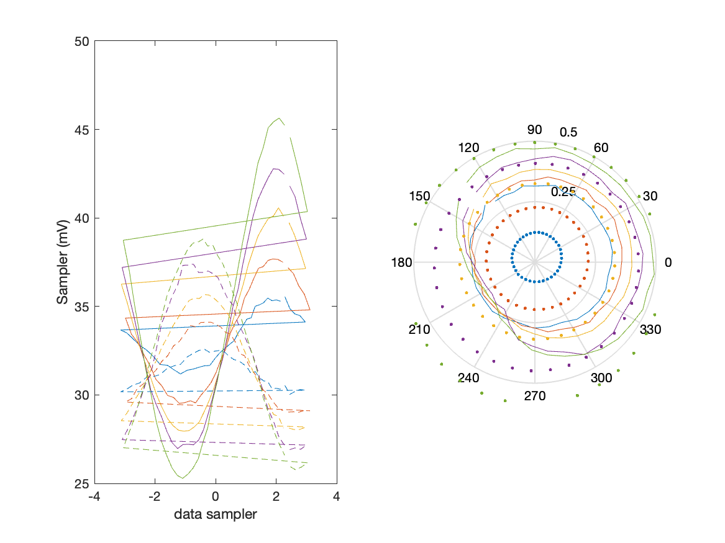
Sampler Performance x^3 Frequency 8.90 GHz, Power 14 dBm
Sampler Av
Sampler 1: 8.523457e-08
Sampler 2: 0.000
Sampler Av3
Sampler 1: 15.003
Sampler 2: 19.478
Sampler Offset (rather than -1)
-0.26427
Goodness Of fit
0

Slide 53
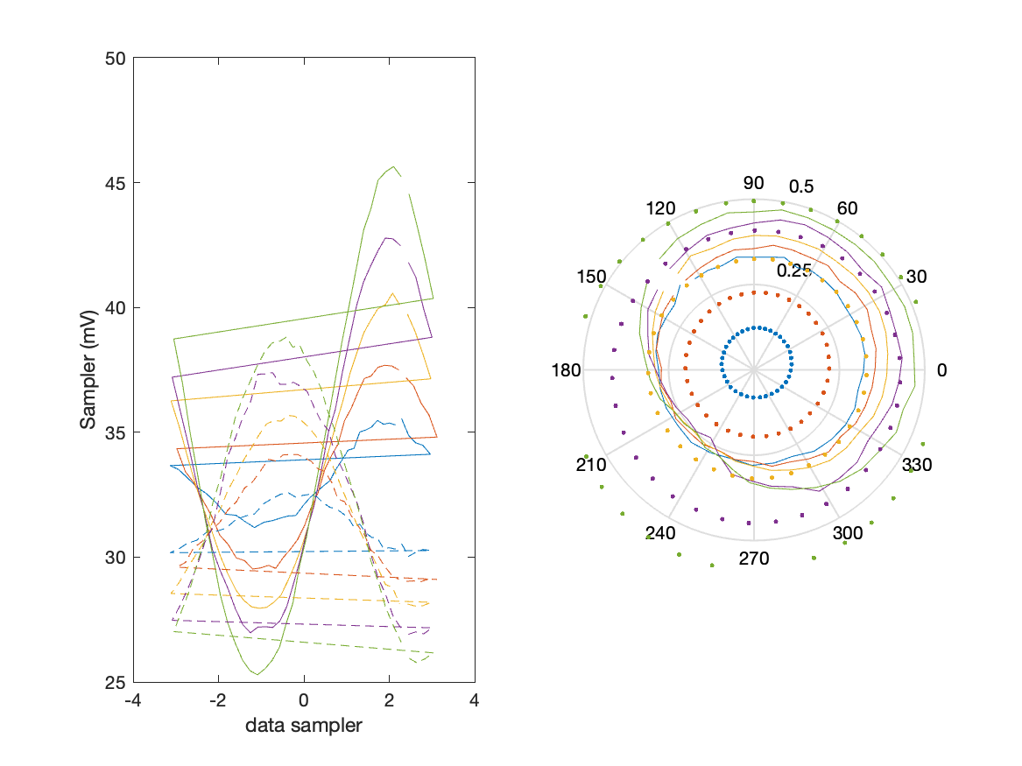
Sampler Performance x^2 x^3 Frequency 8.90 GHz, Power 14 dBm
Sampler Av
Sampler 1: 8.867
Sampler 2: 0.008
Sampler Av3
Sampler 1: 10.261
Sampler 2: 18.753
Sampler Av2
Sampler 1: 0.542
Sampler 2: 0.594
Sampler Offset (rather than -1)
-0.44403
Goodness Of fit
0

Slide 54
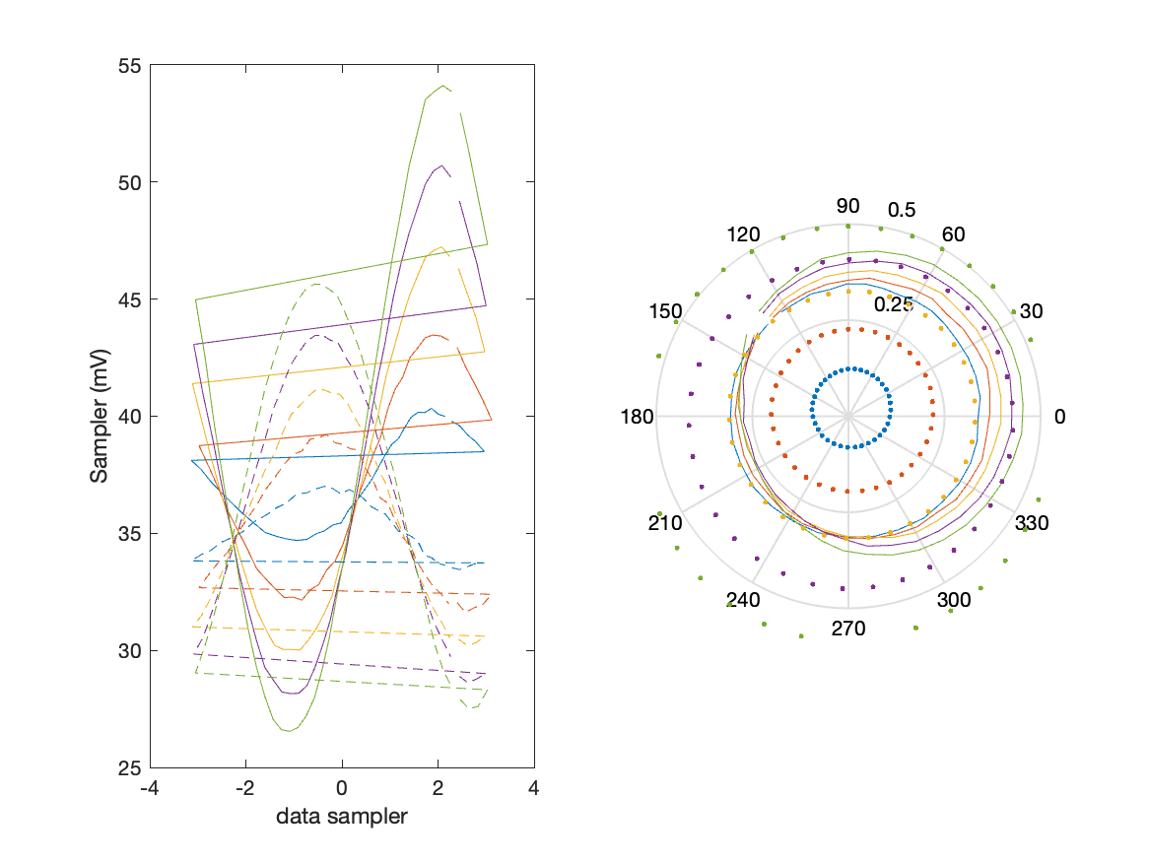
Sampler Performance Frequency 8.90 GHz, Power 16 dBm
Sampler Av
Sampler 1: 6.701
Sampler 2: 13.170
Sampler Offset (rather than -1)
-0.60676
Goodness Of fit
0

Slide 55
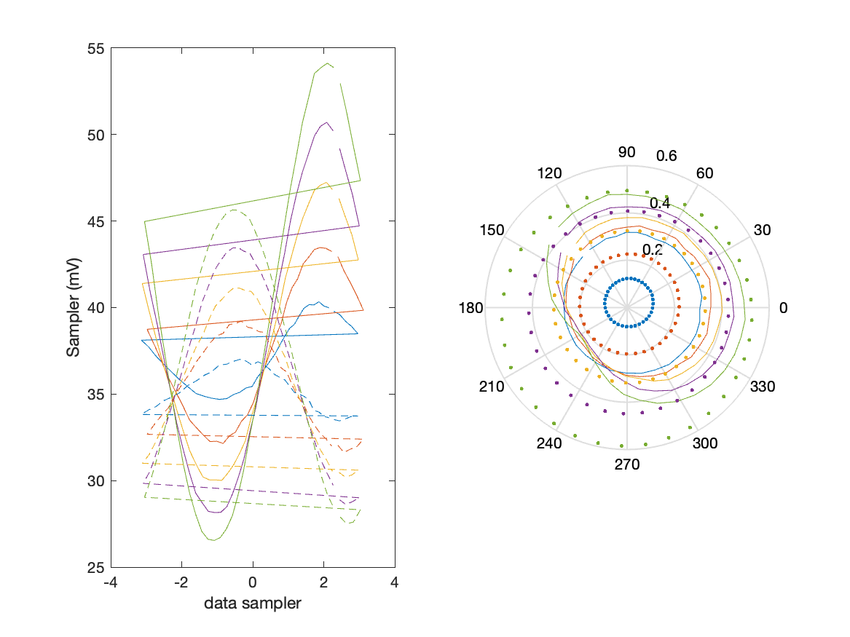
Sampler Performance x^3 Frequency 8.90 GHz, Power 16 dBm
Sampler Av
Sampler 1: 1.555021e-10
Sampler 2: 0.000
Sampler Av3
Sampler 1: 12.419
Sampler 2: 16.052
Sampler Offset (rather than -1)
-0.1949
Goodness Of fit
0

Slide 56
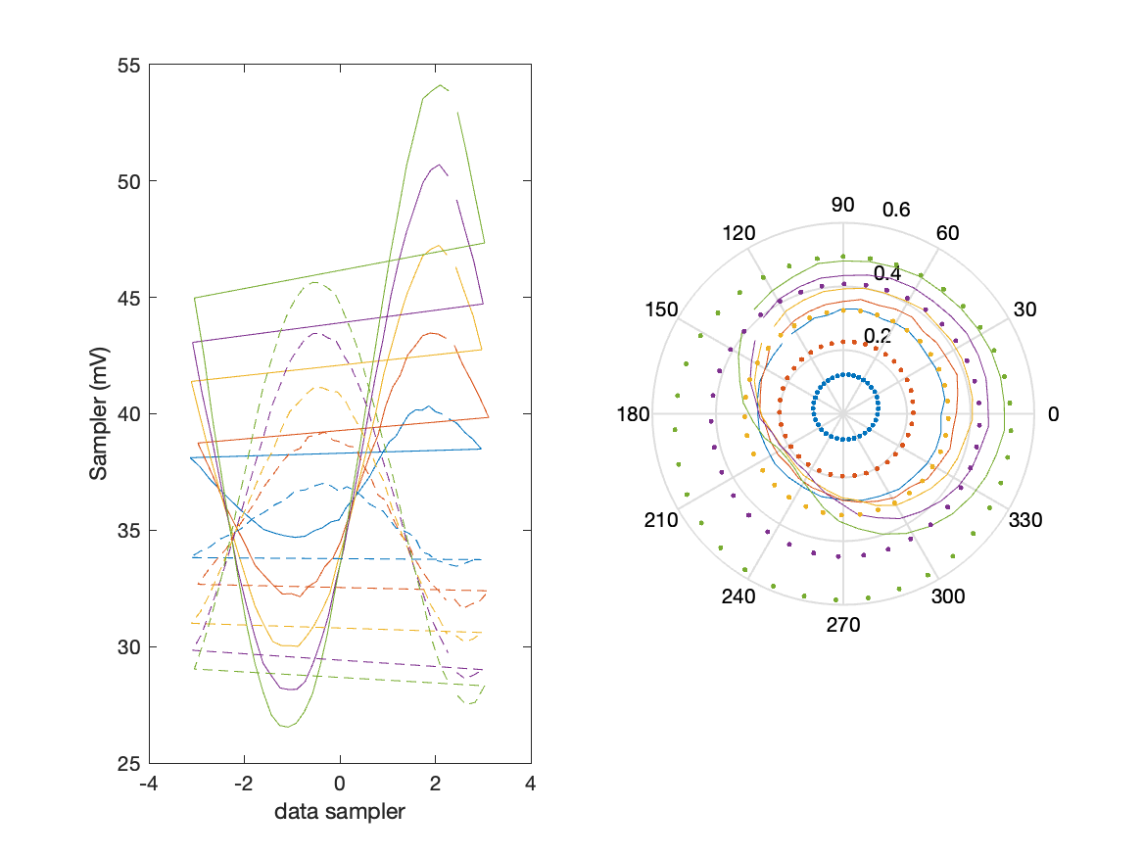
Sampler Performance x^2 x^3 Frequency 8.90 GHz, Power 16 dBm
Sampler Av
Sampler 1: 7.938
Sampler 2: 2.251
Sampler Av3
Sampler 1: 8.658
Sampler 2: 16.041
Sampler Av2
Sampler 1: 0.161
Sampler 2: -0.077
Sampler Offset (rather than -1)
-0.5022
Goodness Of fit
0

Slide 57
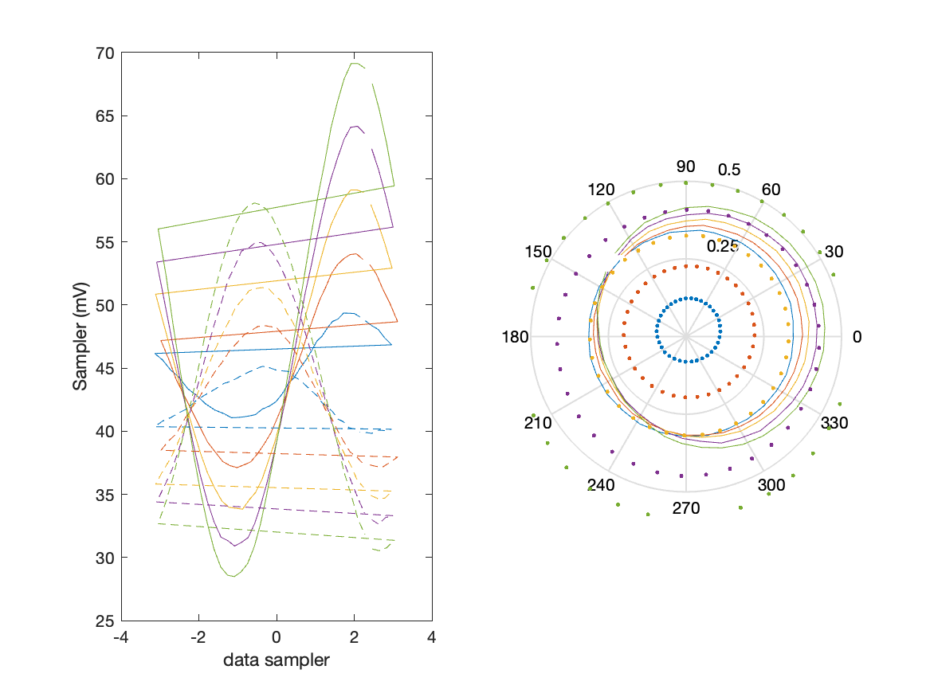
Sampler Performance Frequency 8.90 GHz, Power 18 dBm
Sampler Av
Sampler 1: 4.287
Sampler 2: 8.259
Sampler Offset (rather than -1)
-0.43307
Goodness Of fit
0

Slide 58

Sampler Performance x^3 Frequency 8.90 GHz, Power 18 dBm
Sampler Av
Sampler 1: 2.220497e-14
Sampler 2: 0.000
Sampler Av3
Sampler 1: 9.635
Sampler 2: 12.314
Sampler Offset (rather than -1)
-0.14026
Goodness Of fit
0

Slide 59
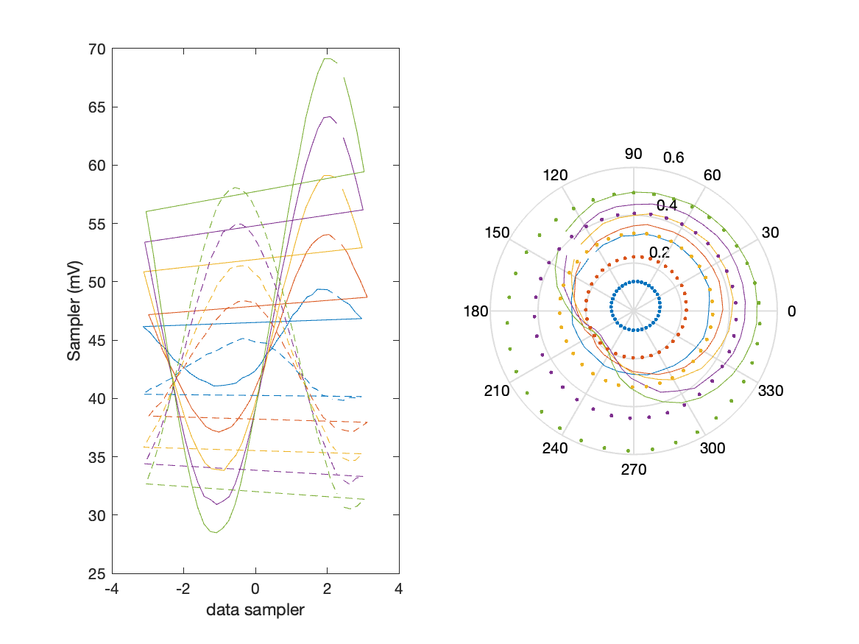
Sampler Performance x^2 x^3 Frequency 8.90 GHz, Power 18 dBm
Sampler Av
Sampler 1: 6.153
Sampler 2: 7.022
Sampler Av3
Sampler 1: 7.346
Sampler 2: 10.952
Sampler Av2
Sampler 1: -0.006
Sampler 2: 0.225
Sampler Offset (rather than -1)
-0.62605
Goodness Of fit
0

Slide 60
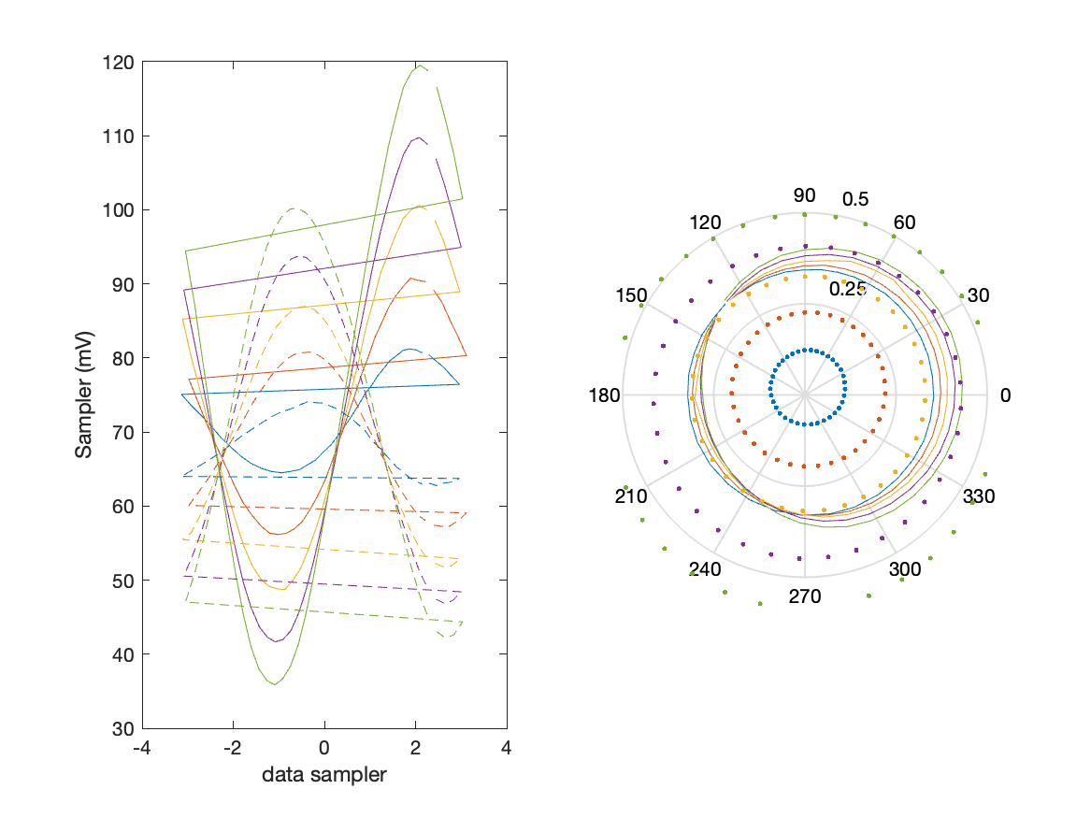
Sampler Performance Frequency 8.90 GHz, Power 22 dBm
Sampler Av
Sampler 1: 1.866
Sampler 2: 3.626
Sampler Offset (rather than -1)
-0.26881
Goodness Of fit
0

Slide 61
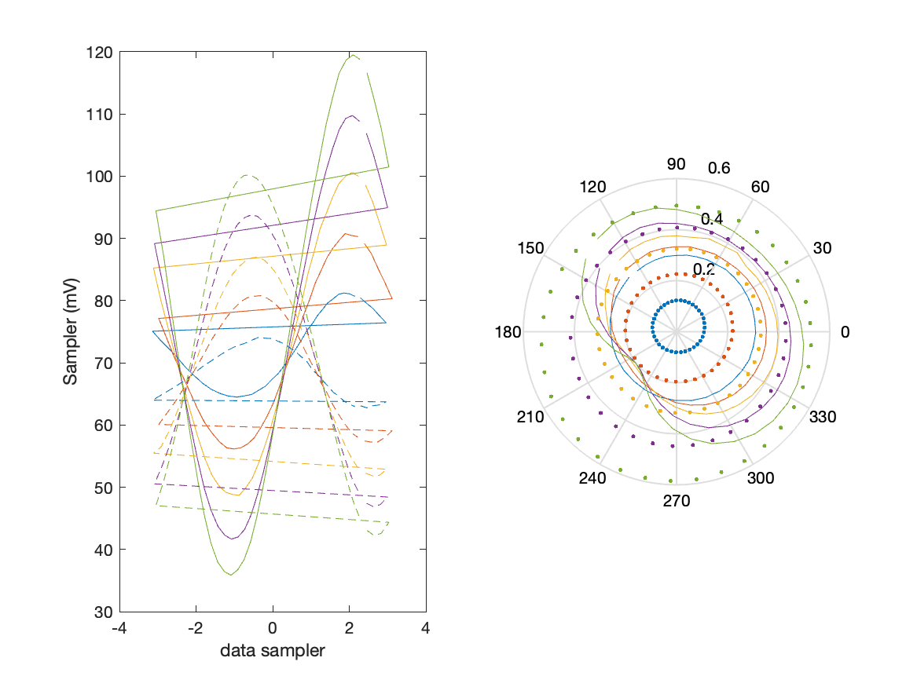
Sampler Performance x^3 Frequency 8.90 GHz, Power 22 dBm
Sampler Av
Sampler 1: 2.221005e-14
Sampler 2: 0.000
Sampler Av3
Sampler 1: 5.620
Sampler 2: 7.080
Sampler Offset (rather than -1)
-0.10141
Goodness Of fit
0

Slide 62
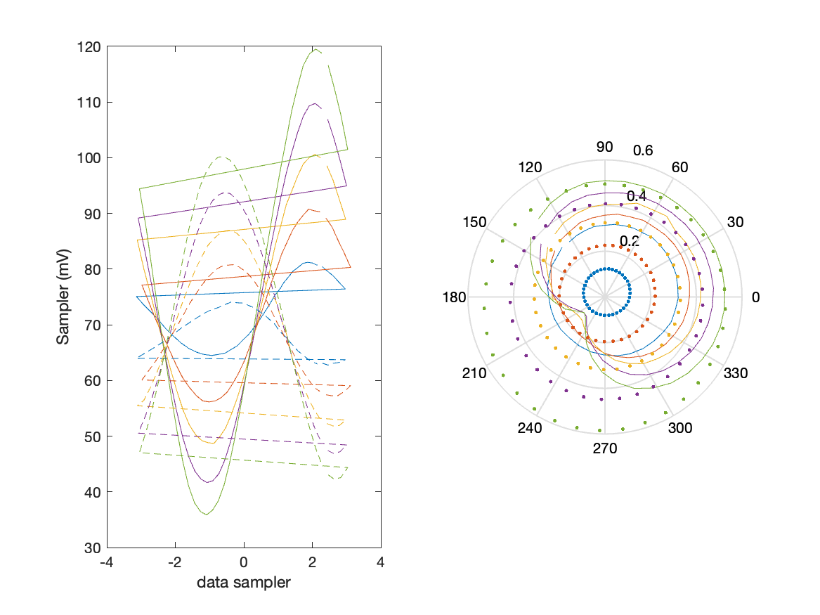
Sampler Performance x^2 x^3 Frequency 8.90 GHz, Power 22 dBm
Sampler Av
Sampler 1: 3.716
Sampler 2: 4.781
Sampler Av3
Sampler 1: 4.461
Sampler 2: 6.218
Sampler Av2
Sampler 1: -0.074
Sampler 2: 0.358
Sampler Offset (rather than -1)
-0.62567
Goodness Of fit
0

Slide 63

Sampler Performance Frequency 9.40 GHz, Power 14 dBm
Sampler Av
Sampler 1: 17.212
Sampler 2: 24.054
Sampler Offset (rather than -1)
-1.2475
Goodness Of fit
0

Slide 64

Sampler Performance x^3 Frequency 9.40 GHz, Power 14 dBm
Sampler Av
Sampler 1: 8.382762e-12
Sampler 2: 0.000
Sampler Av3
Sampler 1: 16.661
Sampler 2: 19.539
Sampler Offset (rather than -1)
-0.33903
Goodness Of fit
0

Slide 65

Sampler Performance x^2 x^3 Frequency 9.40 GHz, Power 14 dBm
Sampler Av
Sampler 1: 8.713
Sampler 2: 0.005
Sampler Av3
Sampler 1: 12.900
Sampler 2: 18.814
Sampler Av2
Sampler 1: 0.390
Sampler 2: -0.375
Sampler Offset (rather than -1)
-0.50422
Goodness Of fit
0

Slide 66

Sampler Performance Frequency 9.40 GHz, Power 16 dBm
Sampler Av
Sampler 1: 12.003
Sampler 2: 16.532
Sampler Offset (rather than -1)
-0.95647
Goodness Of fit
0

Slide 67

Sampler Performance x^3 Frequency 9.40 GHz, Power 16 dBm
Sampler Av
Sampler 1: 5.684795e-09
Sampler 2: 0.000
Sampler Av3
Sampler 1: 13.592
Sampler 2: 15.859
Sampler Offset (rather than -1)
-0.25255
Goodness Of fit
0

Slide 68

Sampler Performance x^2 x^3 Frequency 9.40 GHz, Power 16 dBm
Sampler Av
Sampler 1: 8.323
Sampler 2: 0.003
Sampler Av3
Sampler 1: 10.275
Sampler 2: 15.976
Sampler Av2
Sampler 1: 0.083
Sampler 2: -0.116
Sampler Offset (rather than -1)
-0.48944
Goodness Of fit
0

Slide 69

Sampler Performance Frequency 9.40 GHz, Power 18 dBm
Sampler Av
Sampler 1: 7.526
Sampler 2: 10.197
Sampler Offset (rather than -1)
-0.68711
Goodness Of fit
0

Slide 70

Sampler Performance x^3 Frequency 9.40 GHz, Power 18 dBm
Sampler Av
Sampler 1: 2.684371e-10
Sampler 2: 0.000
Sampler Av3
Sampler 1: 10.334
Sampler 2: 11.967
Sampler Offset (rather than -1)
-0.17422
Goodness Of fit
0

Slide 71

Sampler Performance x^2 x^3 Frequency 9.40 GHz, Power 18 dBm
Sampler Av
Sampler 1: 6.878
Sampler 2: 7.175
Sampler Av3
Sampler 1: 7.477
Sampler 2: 9.824
Sampler Av2
Sampler 1: 0.391
Sampler 2: -0.120
Sampler Offset (rather than -1)
-0.66279
Goodness Of fit
0

Slide 72

Sampler Performance Frequency 9.40 GHz, Power 22 dBm
Sampler Av
Sampler 1: 3.296
Sampler 2: 4.330
Sampler Offset (rather than -1)
-0.44115
Goodness Of fit
0

Slide 73

Sampler Performance x^3 Frequency 9.40 GHz, Power 22 dBm
Sampler Av
Sampler 1: 2.220459e-14
Sampler 2: 0.000
Sampler Av3
Sampler 1: 5.843
Sampler 2: 6.637
Sampler Offset (rather than -1)
-0.11094
Goodness Of fit
0

Slide 74

Sampler Performance x^2 x^3 Frequency 9.40 GHz, Power 22 dBm
Sampler Av
Sampler 1: 4.885
Sampler 2: 5.863
Sampler Av3
Sampler 1: 3.934
Sampler 2: 4.755
Sampler Av2
Sampler 1: 0.048
Sampler 2: -0.058
Sampler Offset (rather than -1)
-0.75143
Goodness Of fit
0

Slide 75

Sampler Performance Frequency 9.90 GHz, Power 14 dBm
Sampler Av
Sampler 1: 22.262
Sampler 2: 39.000
Sampler Offset (rather than -1)
-1.832
Goodness Of fit
0

Slide 76

Sampler Performance x^3 Frequency 9.90 GHz, Power 14 dBm
Sampler Av
Sampler 1: 1.040753e-09
Sampler 2: 0.000
Sampler Av3
Sampler 1: 18.241
Sampler 2: 22.896
Sampler Offset (rather than -1)
-0.48609
Goodness Of fit
0

Slide 77

Sampler Performance x^2 x^3 Frequency 9.90 GHz, Power 14 dBm
Sampler Av
Sampler 1: 4.276
Sampler 2: 4.088
Sampler Av3
Sampler 1: 16.806
Sampler 2: 21.894
Sampler Av2
Sampler 1: -0.104
Sampler 2: 0.030
Sampler Offset (rather than -1)
-0.65724
Goodness Of fit
0

Slide 78

Sampler Performance Frequency 9.90 GHz, Power 16 dBm
Sampler Av
Sampler 1: 13.538
Sampler 2: 24.666
Sampler Offset (rather than -1)
-1.2565
Goodness Of fit
0

Slide 79

Sampler Performance x^3 Frequency 9.90 GHz, Power 16 dBm
Sampler Av
Sampler 1: 2.264387e-12
Sampler 2: 0.000
Sampler Av3
Sampler 1: 14.622
Sampler 2: 18.509
Sampler Offset (rather than -1)
-0.34814
Goodness Of fit
0

Slide 80

Sampler Performance x^2 x^3 Frequency 9.90 GHz, Power 16 dBm
Sampler Av
Sampler 1: 8.167
Sampler 2: 0.023
Sampler Av3
Sampler 1: 10.613
Sampler 2: 18.401
Sampler Av2
Sampler 1: 0.451
Sampler 2: -0.189
Sampler Offset (rather than -1)
-0.54011
Goodness Of fit
0

Slide 81

Sampler Performance Frequency 9.90 GHz, Power 18 dBm
Sampler Av
Sampler 1: 9.321
Sampler 2: 16.957
Sampler Offset (rather than -1)
-1.0166
Goodness Of fit
0

Slide 82

Sampler Performance x^3 Frequency 9.90 GHz, Power 18 dBm
Sampler Av
Sampler 1: 5.132481e-10
Sampler 2: 0.000
Sampler Av3
Sampler 1: 11.145
Sampler 2: 14.171
Sampler Offset (rather than -1)
-0.25322
Goodness Of fit
0

Slide 83

Sampler Performance x^2 x^3 Frequency 9.90 GHz, Power 18 dBm
Sampler Av
Sampler 1: 0.836
Sampler 2: 0.004
Sampler Av3
Sampler 1: 9.507
Sampler 2: 12.620
Sampler Av2
Sampler 1: -1.042
Sampler 2: 2.728
Sampler Offset (rather than -1)
-0.1849
Goodness Of fit
0

Slide 84

Sampler Performance Frequency 9.90 GHz, Power 22 dBm
Sampler Av
Sampler 1: 4.024
Sampler 2: 7.467
Sampler Offset (rather than -1)
-0.66467
Goodness Of fit
0

Slide 85

Sampler Performance x^3 Frequency 9.90 GHz, Power 22 dBm
Sampler Av
Sampler 1: 2.220658e-14
Sampler 2: 0.000
Sampler Av3
Sampler 1: 6.294
Sampler 2: 7.964
Sampler Offset (rather than -1)
-0.15819
Goodness Of fit
0

Slide 86

Sampler Performance x^2 x^3 Frequency 9.90 GHz, Power 22 dBm
Sampler Av
Sampler 1: 5.209
Sampler 2: 6.954
Sampler Av3
Sampler 1: 4.697
Sampler 2: 6.664
Sampler Av2
Sampler 1: 0.068
Sampler 2: -0.150
Sampler Offset (rather than -1)
-0.85501
Goodness Of fit
0

